Slide 1
Australian National Aged Care Classification (AN-ACC)
Professor Kathy Eagar
Director, Australian Health Services Research Institute
NSW Falls Prevention and Healthy Ageing Network
Virtual Conference, 30 April 2021

Slide 2
Overview
Profile of people living in residential aged care in 2021
Outline the new Australian National Aged Care Classification (AN-ACC)
  Designed to replace the current ACFI
      ACFI is no longer fit for purpose
      Inequitable outcomes (geographic and socioeconomic)
      Creates perverse incentives for income maximisation resulting in funding uncertainty

Slide 3
Profile and care needs of residents
The important place to start

Slide 4
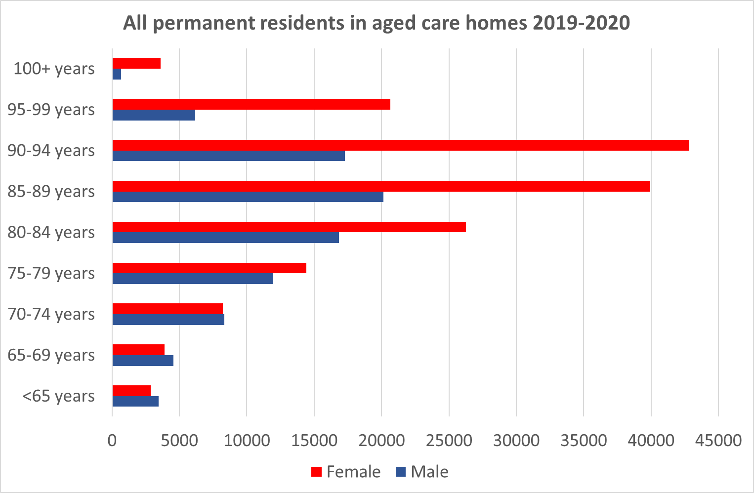
180,000 beds
240,000 residents pa
60,000 deaths, another 60,000 take their place
30,000 people over 95 years
4,300 aged 100-108 years
64% women

Slide 5
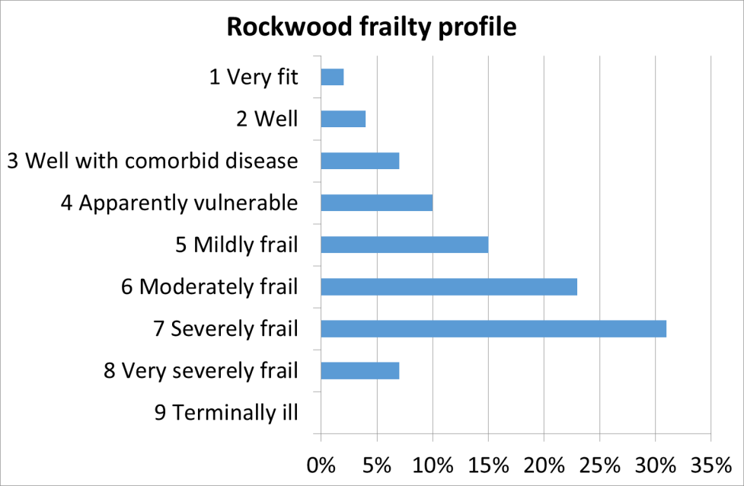
Frailty Profile

Slide 6
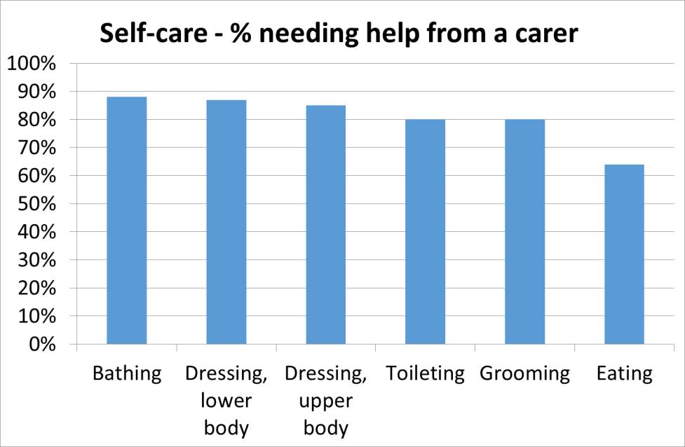

Slide 7
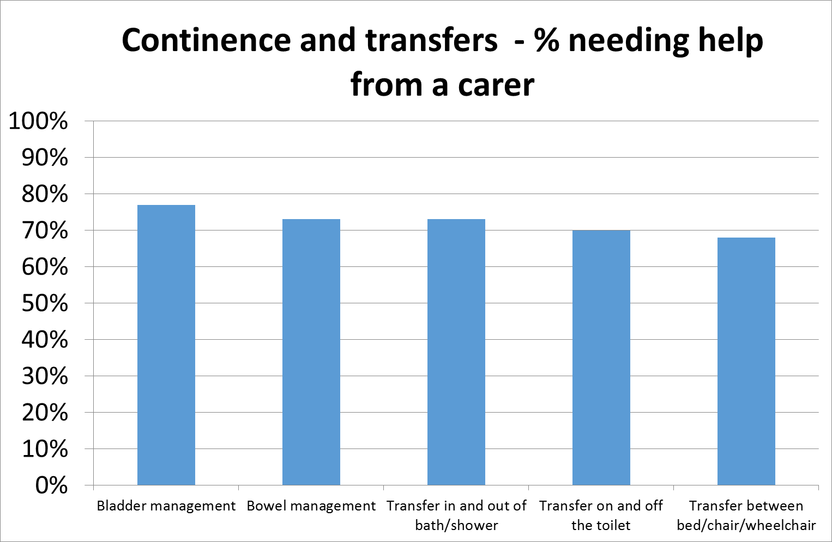

Slide 8
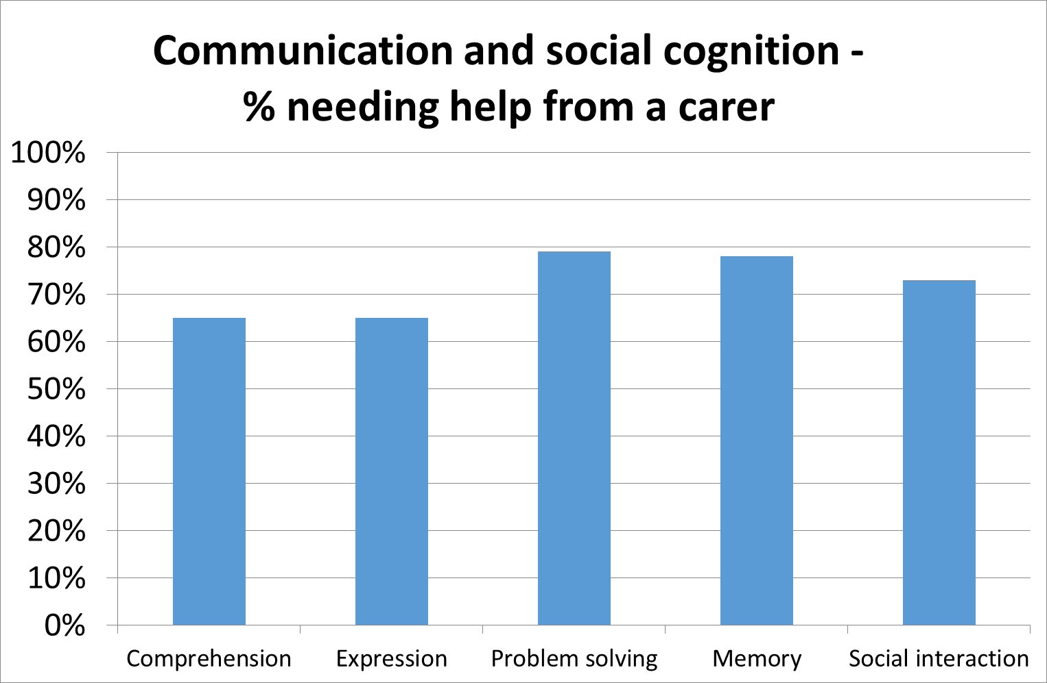

Slide 9
The Australian National Aged Care Classification (AN-ACC) and funding model
Expect government to announce AN-ACC in the May 2021 budget

Slide 10
Six core elements (1)
Separate assessment for funding from assessment for care planning
Assessment for care planning to be undertaken by the residential aged care facility
  based on resident needs, strengths and preferences
Assessment for funding purposes to be undertaken by external assessors
  capturing only the information necessary to assign a resident to a payment class

Slide 11
Six core elements (2)
One-off Adjustment payment for each new resident
  recognising additional, but time-limited, resource requirements when someone initially enters residential care
Base Care Tariff: covers the fixed daily costs of care that are shared equally by all residents (~50%)
  varies by location
AN-ACC Care Payment: variable price per day for the costs of individualised care for each resident (~50%)
  based on each resident’s AN-ACC class
  price per class is standardised across Australia

Slide 12
What drives care costs?
Not medical diagnosis / diagnoses
  So Diagnosis Related Group concepts are not relevant
Costs are driven by care burden from:
  Mobility, end of life needs, frailty, functional decline, cognition, behaviour and technical nursing needs
These may be due to one or more diagnoses
  Including dementia, mental health disorders, physical health etc
  But the diagnosis per se is not a cost-driver

Slide 13
‘Capacity’ drives care needs and costs
AN-ACC assessment captures resident capacity taking into account:
  Physical ability (including pain)
  Cognitive ability (including ability to communicate, sequence, socially interact, problem solve, memory)
  Mental health issues (including depression and anxiety)
  Behaviour (including cooperation, physical agitation, wandering, passive resistance, verbal aggression etc)
It thus captures the functional consequences of health conditions (eg, dementia) rather than the condition itself

Slide 14
All residents
Independent mobility (15%)
Higher cognitive ability
Medium cognitive ability
Higher function
Without CF
Class 12
Class 1 Admit for Palliative Care
Mobility
Not mobile (35%)
Assisted mobility (50%)
Without CF
Class 4
With CF
Class 5
Low cognitive ability
Class 8
Without CF
Class 9
Lower function and lower pressure sore risk
Class 11
With CF
Class 10
Lower function and higher pressure sore risk
With CF Class 13
Without CF
Class 2
With CF
Class 3
Without CF
Class 6
With CF
Class 7
AN-ACC V1
CF = Compounding Factors

Slide 15
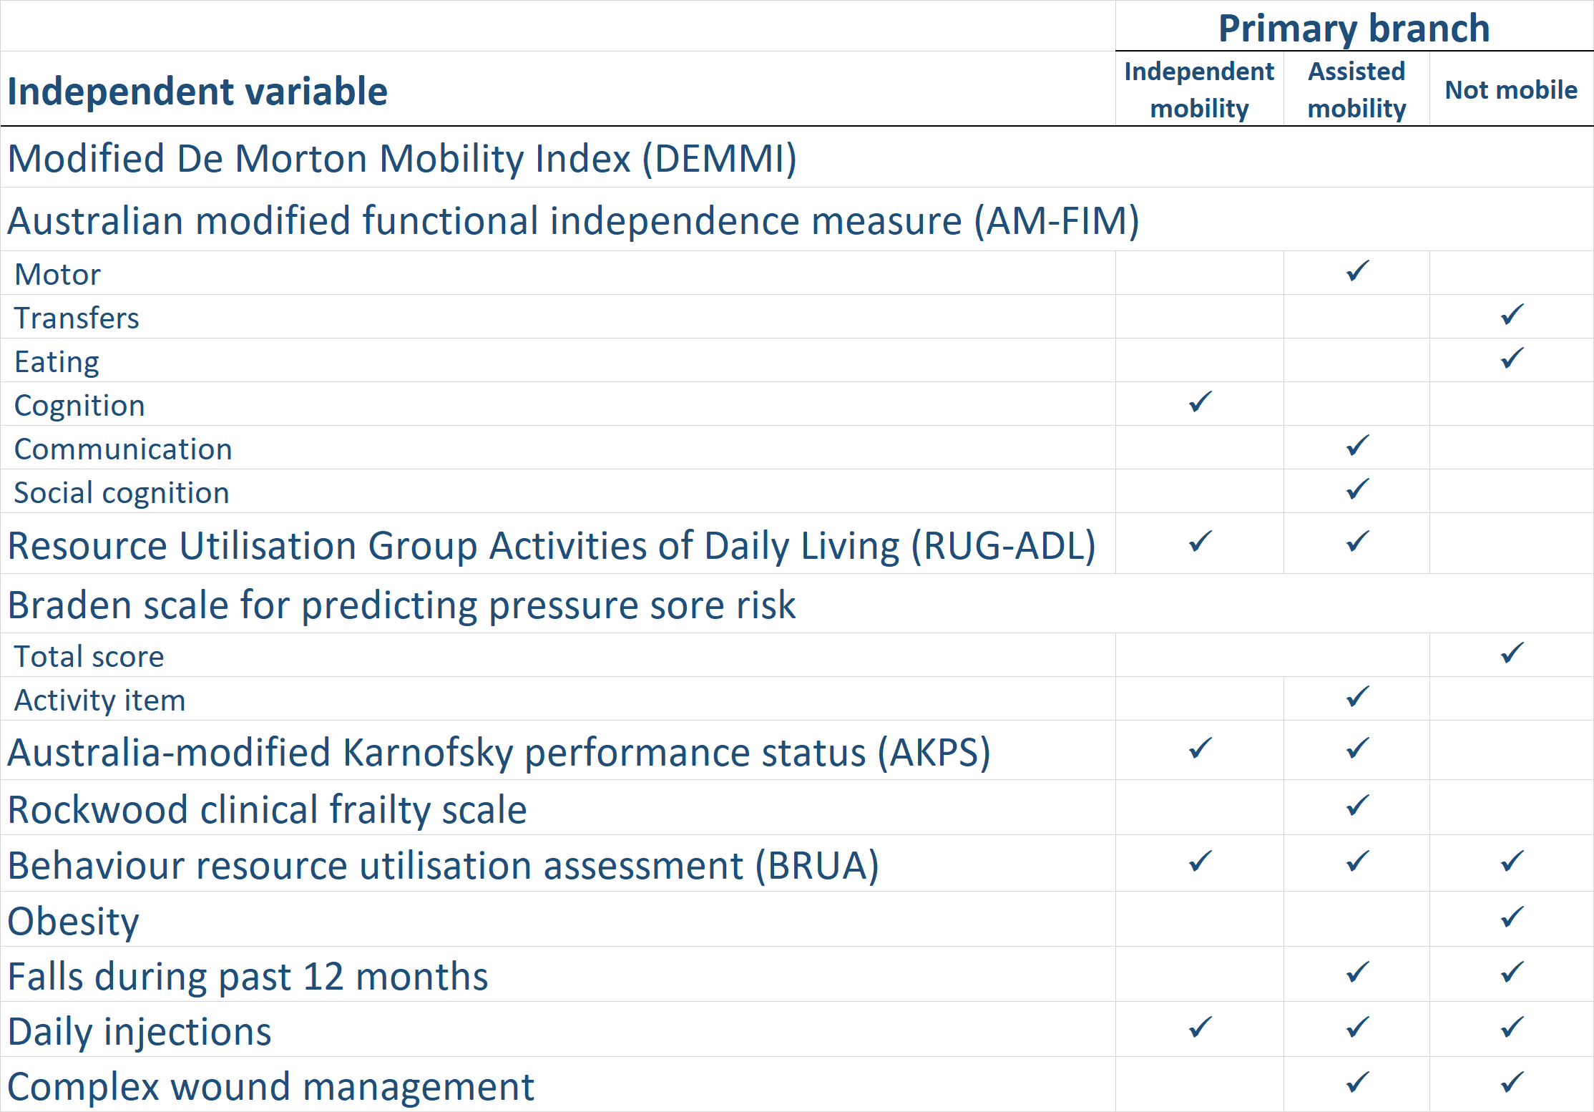
Compounding factors in each branch

Slide 16
Each AN-ACC class
Represents residents with similar needs for care
  hence an evidence-based predictor of inputs (staff time)
Represents residents who cost about the same to care for each day
  hence an evidence-based unit of output (payment )
Represents residents whose clinical risks and outcomes are similar
  hence an evidence-based way of measuring outcomes by risk adjusting quality and safety indicators

Slide 17
Relative individual care time by class
All residents 100%
Independent mobility
Higher cognitive ability
Medium cognitive ability
Higher function
Without CF
Class 12
159%
Class 1 Admit for Palliative Care
195%
Mobility (DEMMI)
Not mobile
Assisted mobility
Without CF
Class 4
41%
With CF
Class 5 73%
Low cognitive ability
Class 8
105%
Without CF
Class 9
106%
Lower function and lower pressure sore risk
Class 11
163%
With CF
Class 10
170%
Lower function and higher pressure sore risk
With CF Class 13
195%
Without CF
Class 2
37%
With CF
Class 3
61%
Without CF
Class 6
69%
With CF
Class 7
95%

Slide 18
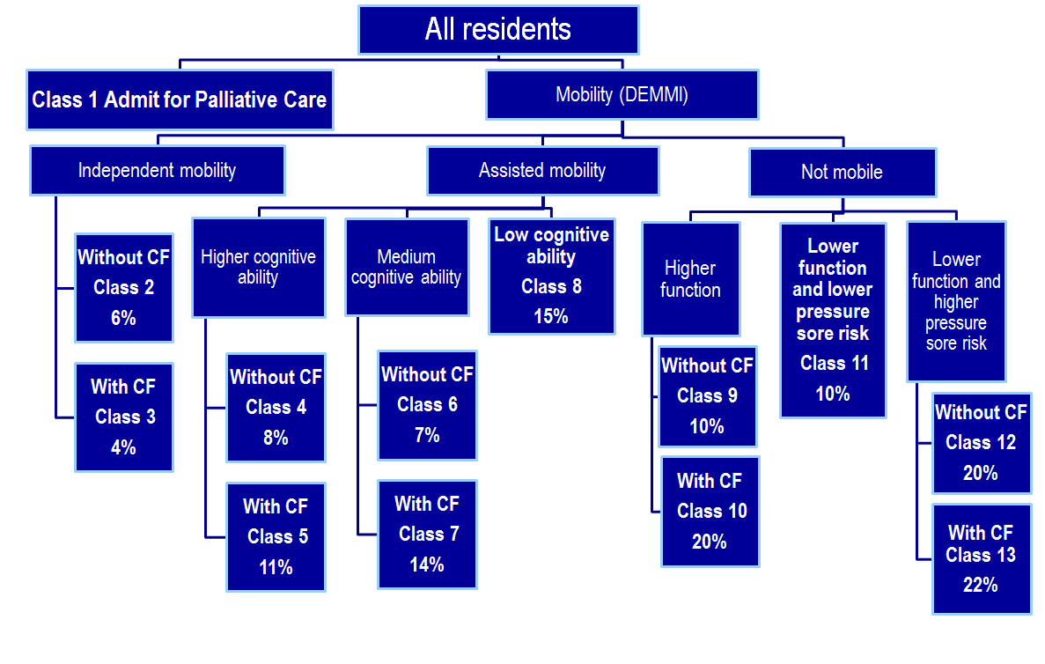
Mortality rates by class 4-6 months after initial AN-ACC assessment

Slide 19
AN-ACC costing and funding model

Slide 20
Base care tariff
Base Care Tariff | Facility description | RVU
1 | Indigenous, MMM=7 | 463%
2 | Indigenous, MMM=6 | 162%
3 | Non-indigenous, MMM=6-7, < 30 beds | 187%
4 | Non-indigenous, MMM=6-7, 30+ beds | 106%
5 | Specialised homeless | 179%
6 | All other RACFs | 95%
All |  | 100%

Slide 21
AN-ACC NWAU
AN-ACC class | Resident description | AN-ACC NWAU
Class 1 | Admit for palliative care | 1.00
Class 2 | Independent without CF | 0.19
Class 3 | Independent with CF | 0.31
Class 4 | Assisted mobility, high cognition, without CF | 0.21
Class 5 | Assisted mobility, high cognition, with CF | 0.37
Class 6 | Assisted mobility, medium cognition, without CF | 0.35
Class 7 | Assisted mobility, medium cognition, with CF | 0.49
Class 8 | Assisted mobility, low cognition | 0.54
Class 9 | Not mobile, higher function, without CF | 0.54
Class 10 | Not mobile, higher function, with CF | 0.87
Class 11 | Not mobile, lower function, lower pressure sore risk | 0.83
Class 12 | Not mobile, lower function, higher pressure sore risk, without CF | 0.81
Class 13 | Not mobile, lower function, higher pressure sore risk, with CF | 1.00
Adjustment payment |  | 5.28

Slide 22
A few of the 30 recommendations

Slide 23
AN-ACC reassessment
That the new AN-ACC funding model allow for reassessment based on significantly increased needs as indicated by:
  (1) a significant hospitalisation
  (2) a significant change in mobility and/or
  (3) a standard time period
    12 months for Classes 2 to 8 (classes with lower mortality rates) and 6 months for Classes 9 to 12 (frailer and higher mortality rates)
That there be no requirement for reassessment in the AN-ACC funding model.

Slide 24
Adjustment payment
That the Commonwealth… build strong accountability into the system to ensure that the adjustment payment be used for the intended purpose, not added to the bottom line and not contracted out to third party providers

Slide 25
Ongoing research and development
That Government commit to an ongoing aged care research and development agenda that builds on the work of the RUCS and that includes assessment, classification, costing and outcome studies.
That a study equivalent to RUCS be undertaken in the community aged care sector with a view to expanding AN-ACC so that it includes aged care delivered in all settings.

Slide 26
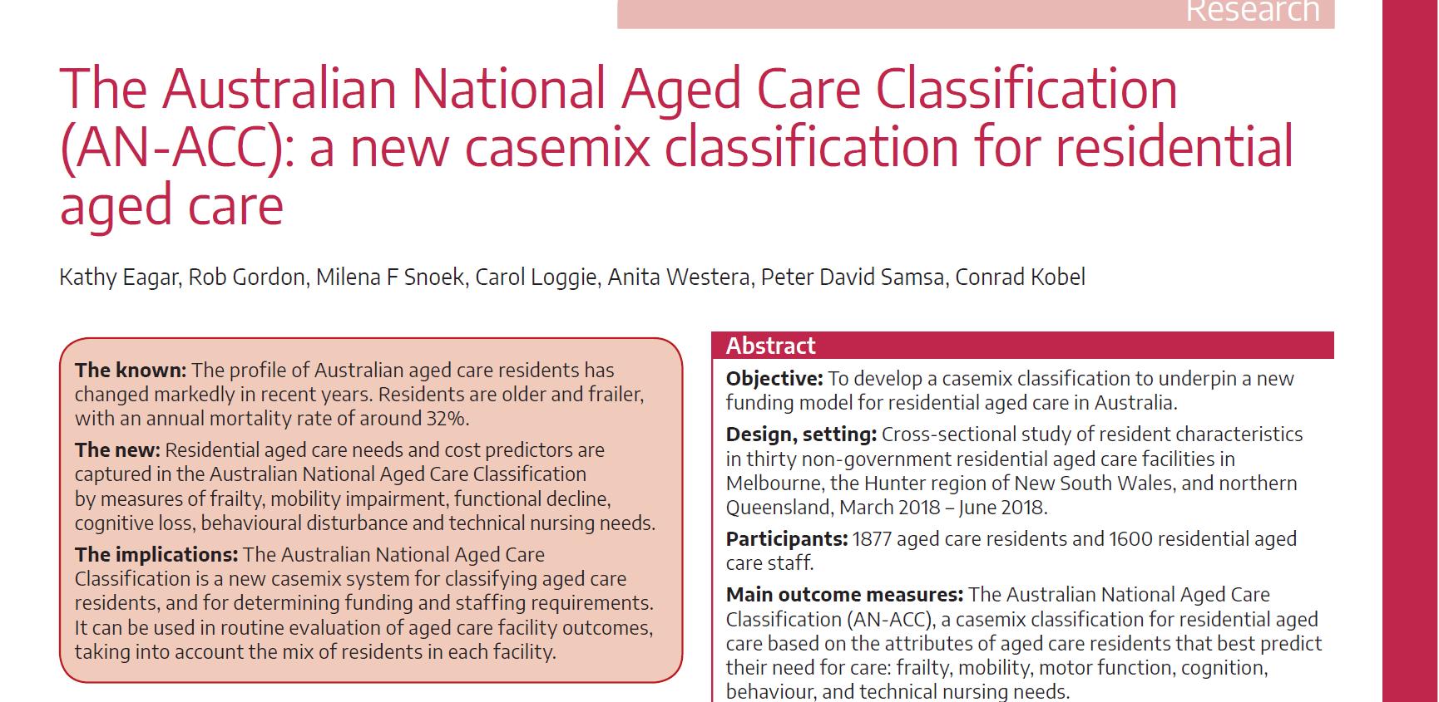
More information
Final reports
  https://agedcare.health.gov.au/reform/resource-utilisation-and-classification-study OR
  https://ahsri.uow.edu.au/rucs/index.html
Journal article
  https://www.mja.com.au/journal/2020/213/8/australian-national-aged-care-classification-acc-new-casemix-classification

