Slide 1
A 3-arm randomised controlled trial of
cognitive-only and cognitive-motor training
to prevent falls in older people
Daina Sturnieks

Slide 2
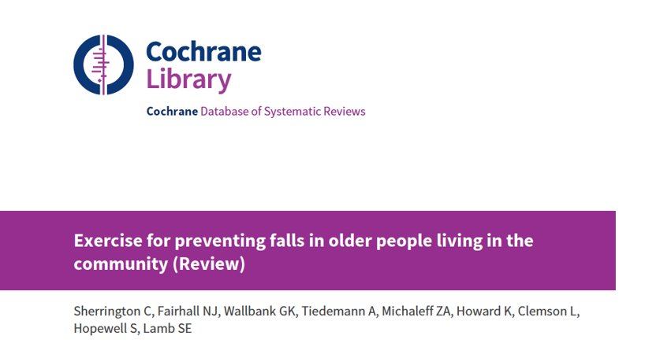
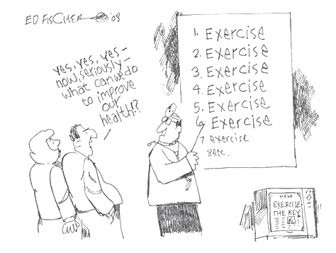
Exercise can prevent falls
Exercise reduces the rate of falls by 23%
RaR 0.77, 95%CI 0.71 to 0.83
12,981 participants
59 studies
high certainty evidence
​
Notes:
Good evidence that exercise can prevent falls, particularly in community dwelling older people
Cochrane review average effect 23%
We know we can get greater benefit with exercise that challenges balance and is of sufficient dose.
However, adherence is a real problem.
We really need novel interventions to get people interested and keep people motivated

Slide 3
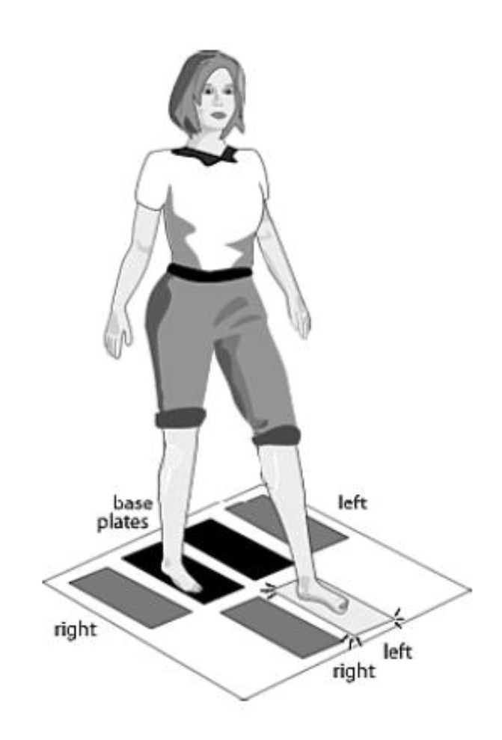
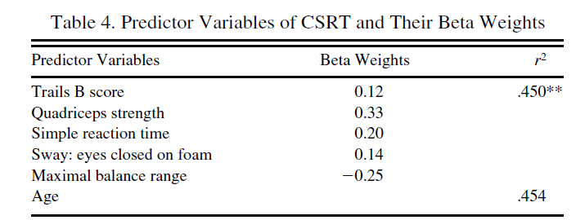
Choice Stepping Reaction Time
.
YOUNG
OLD LOW RISK
OLD HIGH RISK
thinking
stepping
Lord & Fitzpatrick. J Gerontol, 2001
on
Notes:
It started with studies of risk factors for falls in older people and this test , designed by Stephen Lord and Richard Fitzpatrick. It is a test of choice stepping reaction time. Participants stand on the dark base plates, with 4 stimulus plates positioned to the side and front. After a random delay, one of the stimulus plates lights up and the task is to step as quickly and accurately as possible.
The speed of accurate stepping was found to discriminate young from old and people with high and low fall risk.
In fact, performance on this test was found to be an independent risk factor for future falls in 477 retirement village residents.
Together with vision and proprioception, it correctly classified 2/3 fallers.
Looking how performance relates to other measures of SM function, This test was found to be a composite measure of executive functioning (cognitive control), strength, speed and balance.
These studies have shown that compared with young people, older people, and more so those at risk of falling, have an impaired ability to initiate and execute quick, accurate voluntary steps, particularly in situations where attention is divided.

Slide 4
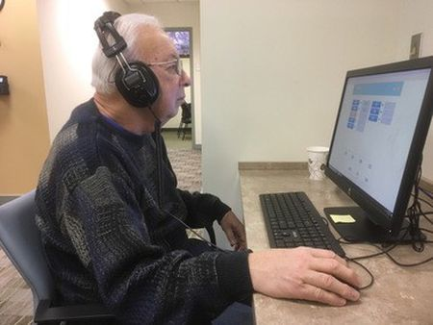
Cognitive training
Cognitive training significantly improves cognitive ability [1].
10 weeks of seated computerised cognitive training improved Timed Up and Go performance in 51 older adults [2].
Seated computerised cognitive training significantly improved gait velocity under single and dual-task conditions [3].
Nguyen et al. 2019. Psychol Bull;145:698-733.
Smith-Ray et al. 2015, J Gerontol B, 70, 357–366.
Verghese, et al. 2010. J Gerontol A, 65, 1338-43.
nj.com
Notes:
there is good evidence that cognitive training can improve cognitive function in older people.
Studies have reported preliminary evidence for physical benefits from seated attention and executive function training.
Cognitive training is easily integrated into exergames.
In an RCT of almost 3000 older adults, Willis et al. [44] found cognitive training significantly improved cognitive ability and produced a modest positive effect on self-reported functional decline [44]. Direct cognitive training effects were retained for 5 years, but any transfer to untrained cognitive functions was not assessed.
A RCT published in Nature [1] which specifically evaluated the role of dual task training using a seated video game, found such training completely remediated age-related deficits in cognitive control that also transferred to untrained cognitive processes in older people.
Smith-Ray et al. [34] found 10 weeks of seated computerised cognitive training significantly improved performance in the Timed Up and Go clinical test of mobility in 51 older adults.
Cognitive remediation training (involving computer games) has also been reported to improve global cognitive scores and Timed Up and Go performance in people with Parkinson’s Disease [21].
Verghese et al. [41] showed that seated computerised cognitive training produced significant improvements in gait velocity under both single and dual-task conditions.
Effect of cognitive remediation on gait in sedentary seniors - PubMed (nih.gov)

Slide 5
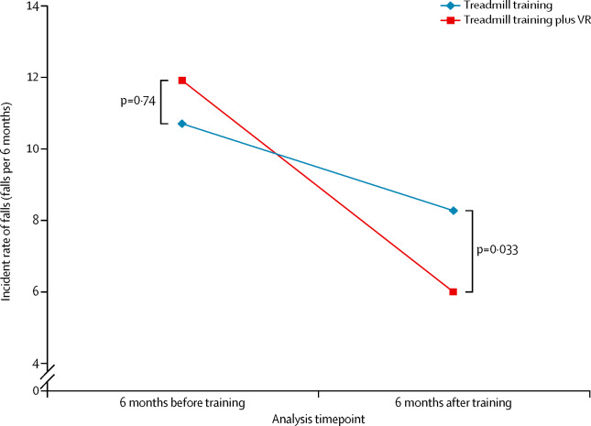
Virtual reality treadmill training
Mirelman, et al. Addition of a non-immersive virtual reality component to treadmill training to reduce fall risk in older adults (V-TIME): a randomised controlled trial. Lancet 2016: 388(10050);1170-1182.
Notes:
One study examining interactive video game training showed a significantly beneficial effect on falls.
VR with motion capture of the participants' feet, which was then projected onto a screen, with challenges in the form of obstacles, pathways, and distractors that required continual adjustment of steps.
6 week training program – clinic based
Participants included 302 people aged 60–90 years at high risk of falls, including
Compared to a treadmill only training group, falls were reduced by 42% in the treadmill training plus VR group in the 6 month period following the end of training
Participants with Parkinson's disease (who represented more than 40% of the study population) benefited the most
secondary outcomes, including gait variability during obstacle negotiation, functional balance and quality of life were significantly improved in the treadmill training plus VR group after training compared with the treadmill training group, with some gains retained at the 6 month follow-up
no differential improvement in executive function was detected in participants assigned to this group (p=0·40 for executive function index, p=0·61 for attention index score). It could be that pen-and-paper cognitive tests are not sensitive enough to detect differences, but might also suggest that the intervention effects were quite specific and restricted to improved gait adaptability in situations requiring focused attention and planning

Slide 6
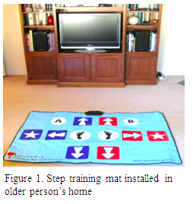
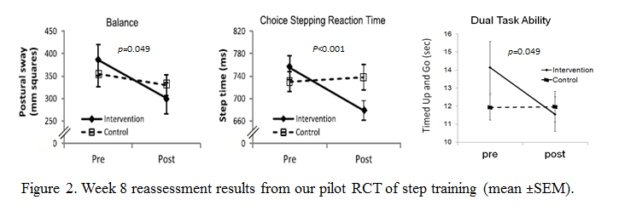
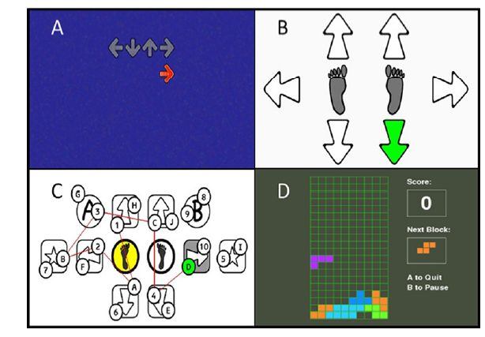
Step training pilot trials
n=37, independent units of retirement village, 1hr/week, 8 weeks
Schoene et al. Plos One, 2013
n=90, community dwelling, 1+hr/week, 16 weeks.
Compared to control, the intervention group improved in measures of processing speed, visuo-spatial ability and concern about falling.
Schoene et al. Plos One, 2015
Notes:
While that study was still underway, we had developed a stepping mat that can be installed into a persons home, wireless and interfaced with the TV for step training. A few games training stepping and some cognitive functions.
We undertook pilot trials in a retirement village for 8 weeks and showed…
A follow up pilot study in the community for 16 weeks found the intervention group not only improved in tests of balance and stepping, but also in assessments of processing speed attention visuo-spatial skills and executive functioning.
Armed with this pilot evidence, we were successful in obtaining grant funding for a large RCT with falls as the primary outcome.

Slide 7
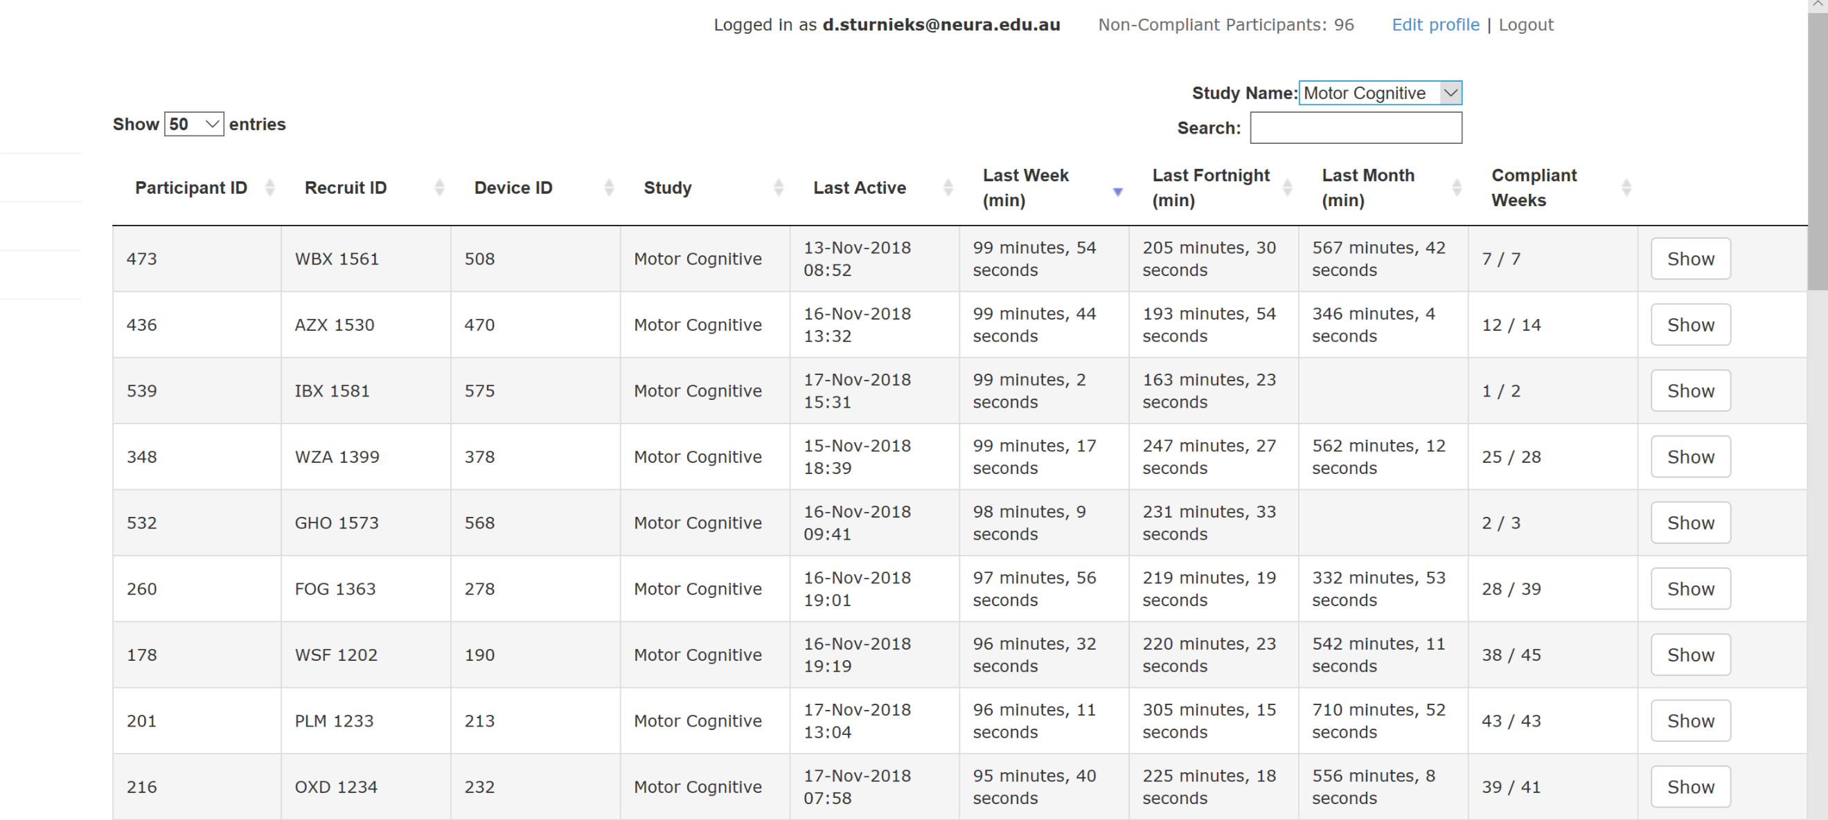
Notes:
We asked people to spend 120 minutes per week using the system.
Able to track compliance since game play data was sent via wifi connection to our server
Compliance – need to call <10%
Dropouts also <10%
Data collection completed in June 2020.

Slide 8
AIM: to determine the effects of cognitive (brain) and cognitive+motor (step) training, compared with a no-intervention control group, on preventing falls in older people.
Trial registration: ACTRN12616001325493
Protocol: Sturnieks DL, et al. BMJ Open. 2019; 9(8): e029409.
Statistical analysis plan: https://osf.io/hz8my/
Notes:
Compare to understand relative contributions from brain and balance training
Large trial, underway for about 4 years.

Slide 9
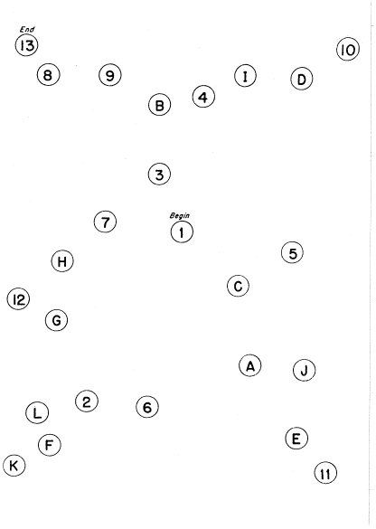
Recruitment
Baseline Assessment
(n=105 MRI)
Secondary outcomes
Balance
Stepping performance and speed
Gait and mobility
Cognitive functions
Neuroplasticity (n=105)
Time 0
Randomisation (n=750)
Cognitive-motor
Step training (n=250)
Cognitive-only Brain Training (n=250)
Control (n=250)
1 - 2 weeks
Home visit
System installation and training
Home visit
System installation and training
Phone call
Falls information sent via post
5-6 weeks
Home visit
Home visit
Phone call
6 months
Blinded reassessment (n=300)
(n=105 MRI)
12 months
Falls follow-up completed
Primary outcome Monthly falls
Notes:
750 participants
aged 65+ years
living independently in the community
no cognitive impairment
Randomised
Intervention HV
Asked to play 2 hours per week
Hv – safety, progression

Slide 10
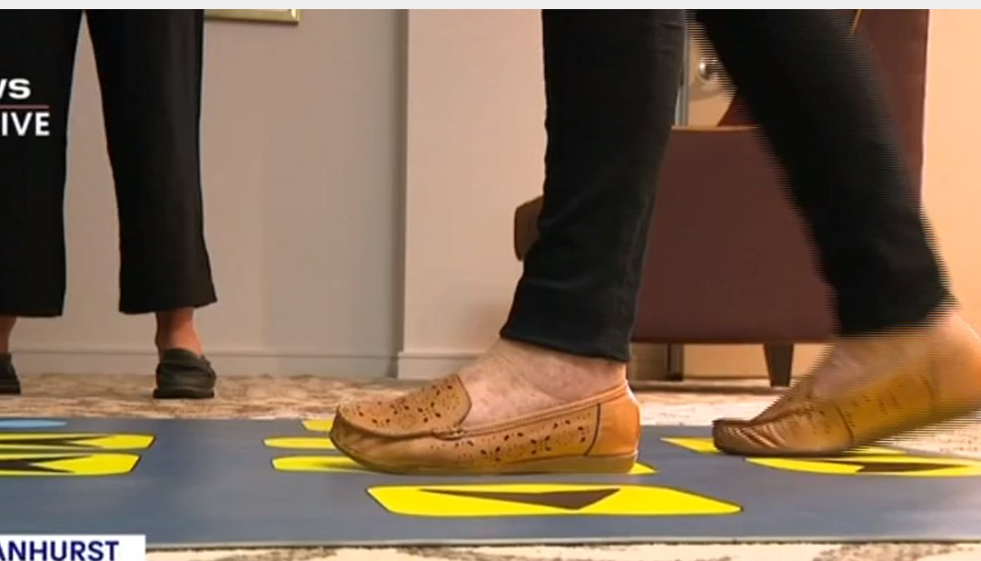
Results - sample
 | Control (n=255) | Step training (n=252) | Brain training (n=262) | p value
Age (years) | 73 ± 5 | 73 ±6 | 73 ±5 | 0.955
Gender (Female) | 182 (71.4%) | 176 (69.8%) | 189 (72.1%) | 0.910
BMI (kg/m2) | 26.9 ± 4.9 | 27.0 ± 5.2 | 27.1 ± 4.9 | 0.901
Years of Education (years) | 16±4 | 16± 4 | 16 ±5 | 0.882
Presence of computer at home (n) | 248 (97.3%) | 242 (96.0%) | 252 (96.2%) | 0.789
Previous internet usage (n) | 251 (98.4%) | 244 (96.8%) | 253 (96.6%) | 0.392
Fell once in last 12 months (n) | 94 (36.9%) | 99 (39.3%) | 90 (34.4%) | 0.469
Had multiple falls in last 12 months (n) | 33 (12.9%) | 41 (16.3%) | 35 (13.4%) | 0.478
Level of disability (WHODAS 2.0) | 7 ±7 | 7±8 | 7 ±7 | 0.703
No. of comorbidities (n) | 1.9 ± 1.5 | 2.1 ±1.5 | 2.1 ±1.6 | 0.261
No. of medications (n) | 2.66 ±2.10 | 3.21 ±2.70 | 3.01 ±2.61 | 0.201
Falls risk score | 0.32 ±1.12 | 0.30 ±1.02 | 0.31 ±0.93 | 0.181
Cognition (ACE-R) | 94 ±5 | 94 ±5 | 94 ±5 | 0.702
Fear of falling (Icon- FES) | 17± 5 | 17 ±5 | 16± 5 | 0.481
Depression (PHQ-9) | 2 ±3 | 2±3 | 2±3 | 0.405

Slide 11
Results - adherence
Step Training
151
Brain Training
193
 | N | Average mins/week | Range | N = 80+ mins/week
Step training | 237 | 80 ±47 | 1—231 | 128
Brain training | 244 | 95 ±i43 | 1—230 | 171

Slide 12
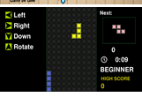
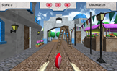
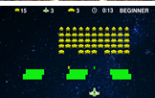
Results – system usability
Tetris
highest rated game
improved significantly from 6 to 12 months
Greek Village, Space Invaders and Anaconda:
least enjoyed games
Ratings reduced with time
Moderate agreement with
medals encouraged me to do the training
the games were challenging
Strong positive agreement with
system usability
People were not concerned about falling while using the equipment
Notes:
Compare to understand relative contributions from brain and balance training
Large trial, underway for about 4 years.
No serious adverse events

Slide 13
Results – primary outcome
 | Fallers | non-fallers | % fallers | n falls | mean falls | Range
control | 123 | 132 | 48 | 201 | 0.91 | 0-13
step training | 91 | 161 | 36 | 146 | 0.65 | 0-11
brain training | 110 | 152 | 42 | 186 | 0.75 | 0-12
Control rate
1
compared to controls,
step training group had IRR=0.74 (95%CI=0.56-0.98)
brain training group had IRR=0.86 (95%CI=0.65-1.12)
0.8
0.86
0.74
0.6
0.4
Step training
Brain training
Notes:
Compare to understand relative contributions from brain and balance training
Large trial, underway for about 4 years.

Slide 14
Results – secondary outcomes

Slide 15
Results – secondary outcomes
*Intention to treat analyses

Slide 16
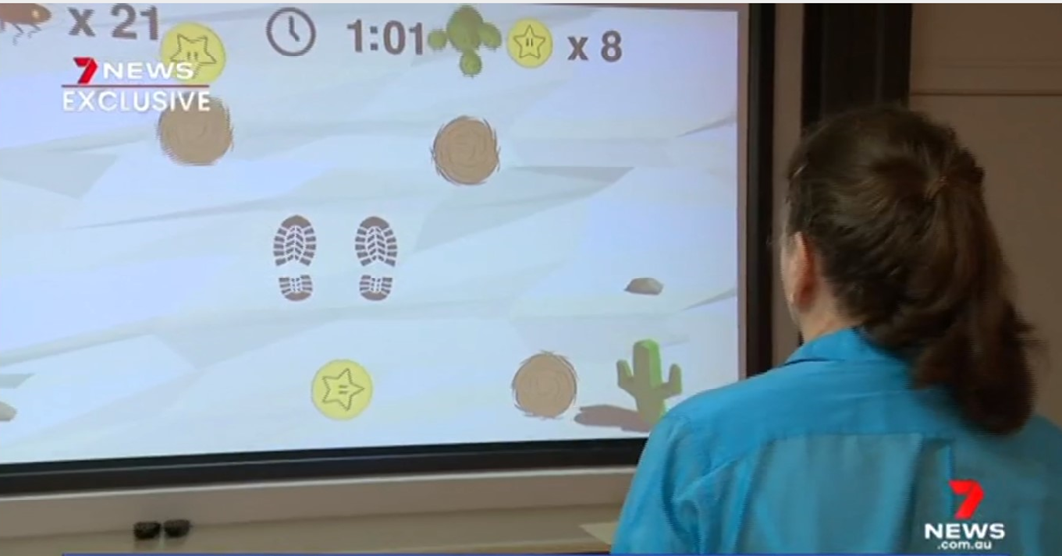
IMPLEMENTATION OF A NOVEL EXERGAMING SYSTEM FOR IMPROVING BALANCE AND MOBILITY IN AGED CARE REHABILITATION

Slide 17
Implementation of a novel exergaming system for improving balance and mobility in Residential Aged Care Facilities: A feasibility study
Notes:
45 aged care facilities across Australia.
Implement and surveys regarding fesability
COVID-19 affected homes where residents were confined to their rooms for weeks and months.
Staff feedback has been very positive, they report noticeable improvements in resident’s function.

Slide 18
Implementation trial – aged care

Slide 19
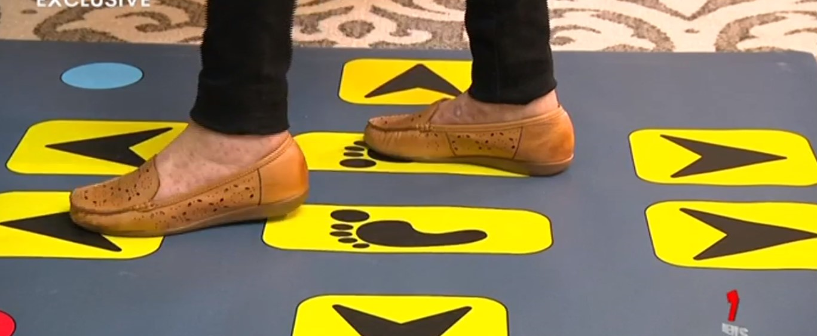
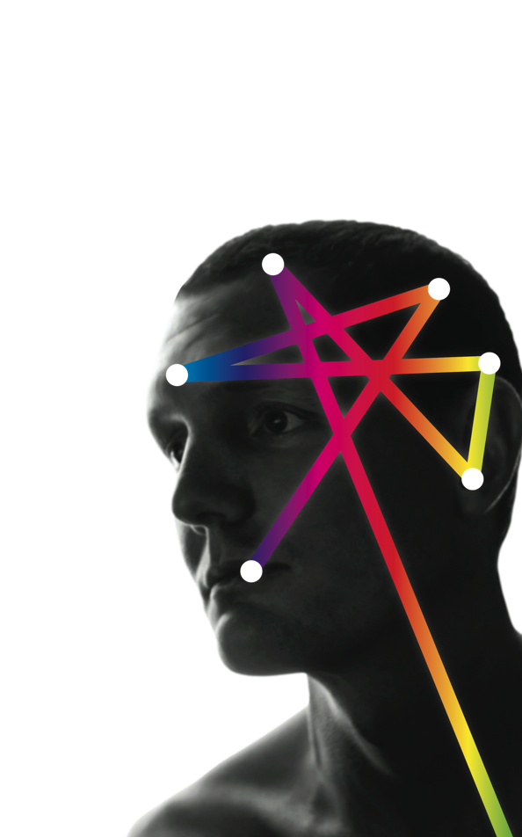
Ashley Woodbury
Barbara Toson
Bethany Halmy Cameron Hicks
Carly Chaplin
Dinaz Perekh
Jacqui Close
Jasmine Menant
Jessica Turner
Joanne Lo
Kim Delbaere
Mayna Ratanapongleka Matt Hand
Natassia Smith
Rob Herbert
Stephen Lord
Dexter Go
George Mitri
Jaime Garcia
Philip Aubert
NeuRA IT
Carolyn Tan
Jeffrey Yu
Amit Lampit
Cathie Sherrington
Kathryn Broadhouse
Marshall Dalton
Michael Valenzuela
Notes:
5 years study
RAs
Co investigators and associate investigators, mentors
Students
IT staff
Participants

Slide 20
Results – flow diagram
Enrolment
Assessed for eligibility (n=832)
Did not meet inclusion criteria (n=16)
Declined to participate (n=13)
Loss to follow up (n=33)
Baseline
Baseline Assessment (n= 770)
Declined to participate (n=1)
Allocation
Randomized (n=769)
Control (n=255)
Step training (n=252)
Brain training (n=262)
Discontinued intervention ♦ Health and safety (n=5) ♦ Loss of interest (n=4)
Lost to follow-up (n=1)
Discontinued intervention ♦ Health and safety (n=6) ♦ Loss of interest (n=6) ♦ Lack of time (n=4) ♦ Personal reasons (n=4)
Discontinued intervention ♦ Health and safety (n=6) ♦ Loss of interest (n=8) ♦ Lack of time (n=9) ♦ Personal reasons (n=2)
Follow-up
Control (n=246)
Step training (n=231)
Brain training (n=237)

Slide 21
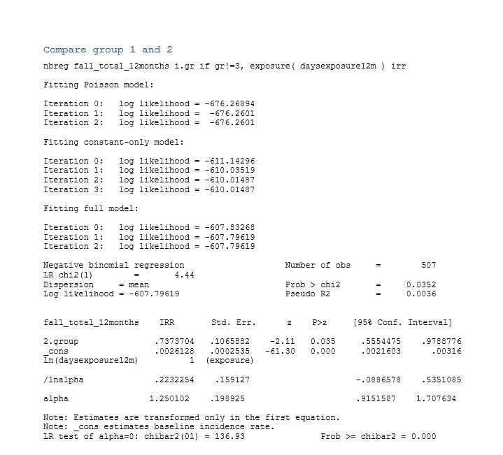
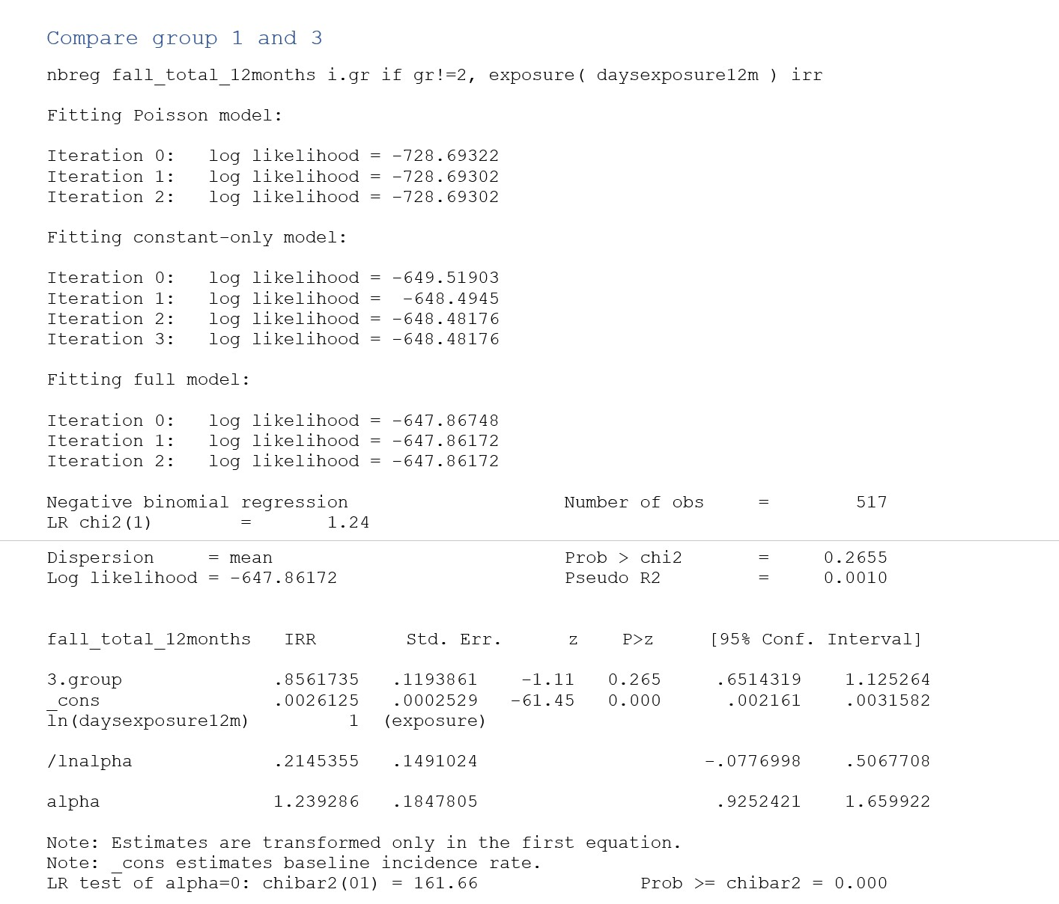
Results – primary outcome
Notes:
Compare to understand relative contributions from brain and balance training
Large trial, underway for about 4 years.

Slide 22
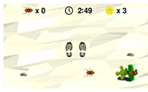
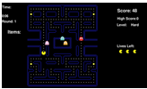

Slide 23
PSYCHOSOCIAL/DEMOGRAPHIC
Advanced age
Falls history
Depression
Living alone
ADL Limitation
Female gender
Inactivity
ENVIRONMENTAL
Poor footwear
Home hazards
External hazards
Inappropriate spectacles
MEDICAL CONDITIONS
Stroke
Incontinence
Parkinson’s disease
Dementia
MEDICATIONS
Psychoactives
Polypharmacy (4+ meds)
SENSORIMOTOR & BALANCE
Muscle weakness
Impaired vision
Reduced peripheral sensation
Slow reaction time
Impaired balance
FALLS
Risk factors for falls

