Slide 1
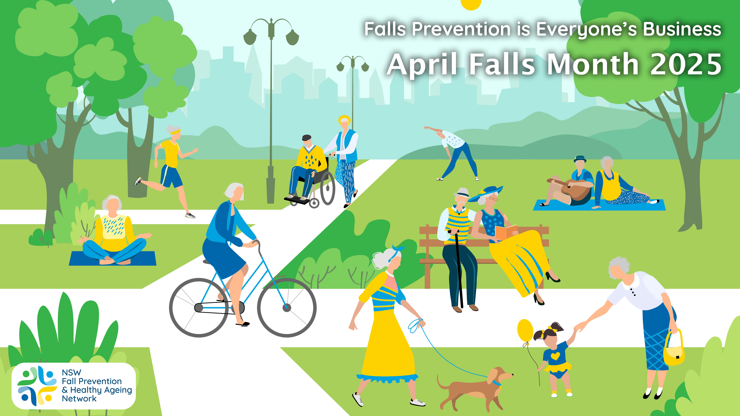

Slide 2
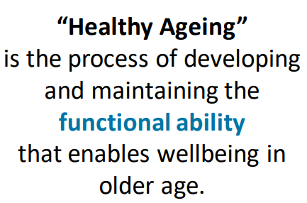
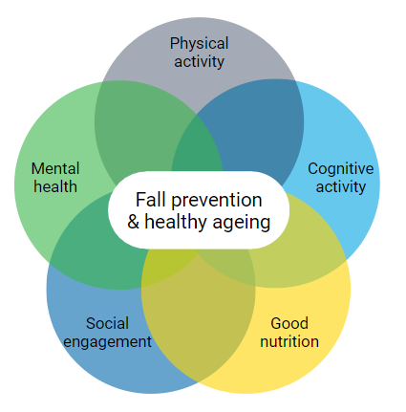

What is Healthy Ageing?
https://fallsnetwork.neura.edu.au/
the-network
https://www.who.int/ageing/decade-of-healthy-ageing

Slide 3
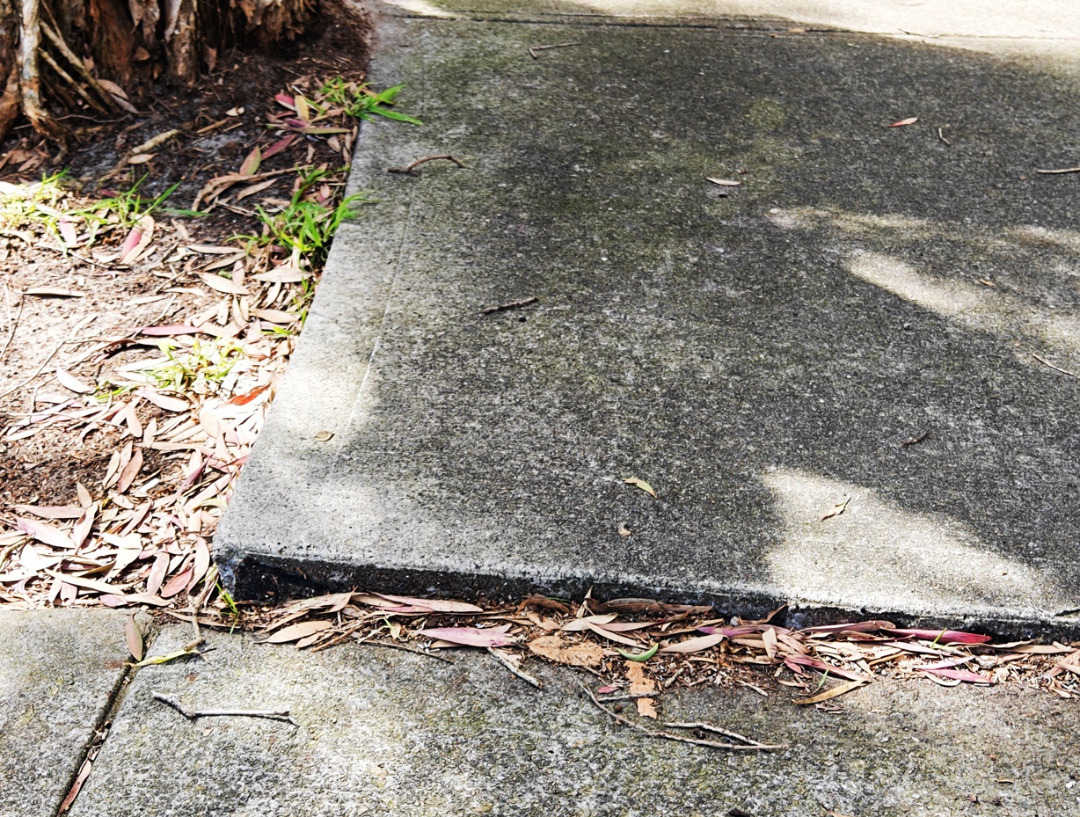
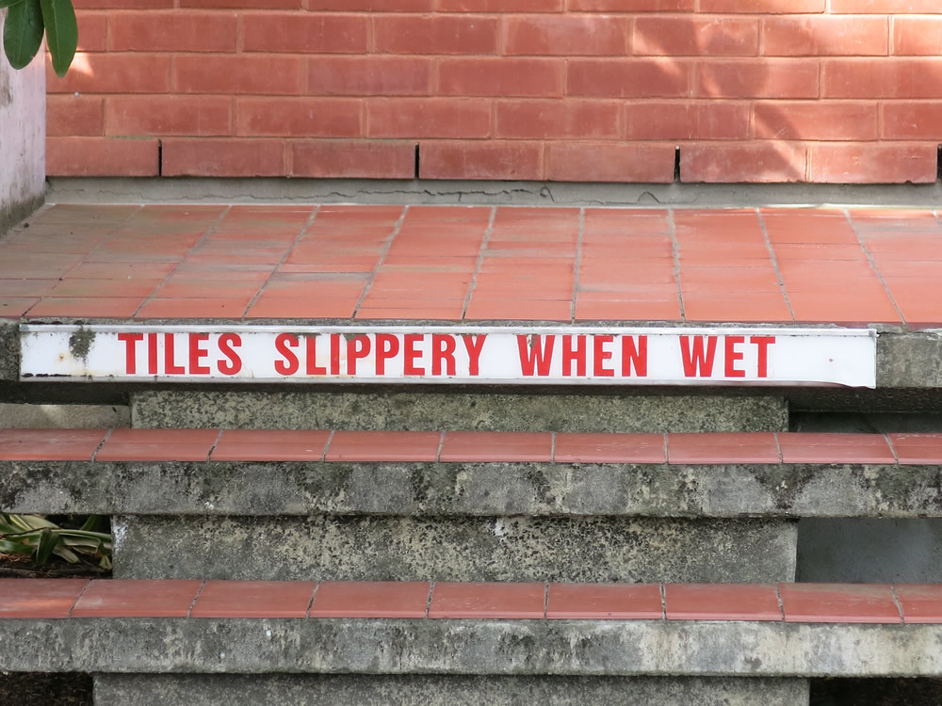
What is a Fall?
A fall is
“an unexpected event which results in a person coming to rest inadvertently on the ground or floor or other lower level”
Examples of fall events
Tripping on tree roots or uneven pavement
Slipping in the bathroom on wet tiles
Losing your balance when reaching to pick something up from the floor
Other examples? Has anyone recently had a fall?
Lamb SE, et al. J Am Geriatr Soc. 2005;53(9):1618-22
https://www.flickr.com/photos/kebabette/16094991640/
Notes:
A fall is defined as an unexpected event which results in a person coming to rest inadvertently on the ground or floor or other lower level
Falls can therefore happen at anytime and any location
Examples:
Tripping on a tree root and landing on the ground
Slipping in the bathroom and landing on the tiles
Losing your balance when reaching down to pick something up from the floor or reaching up to get something from the cupboard
Fall in the kitchen when bending down to pick something up off the floor
Falling from a height such as a ladder when cleaning gutters
Falling when getting out of bed
Losing your balance when getting up from the chair
Who can give me some other examples of a fall? Or has anyone fallen recently and would like to share their experience?

Slide 4


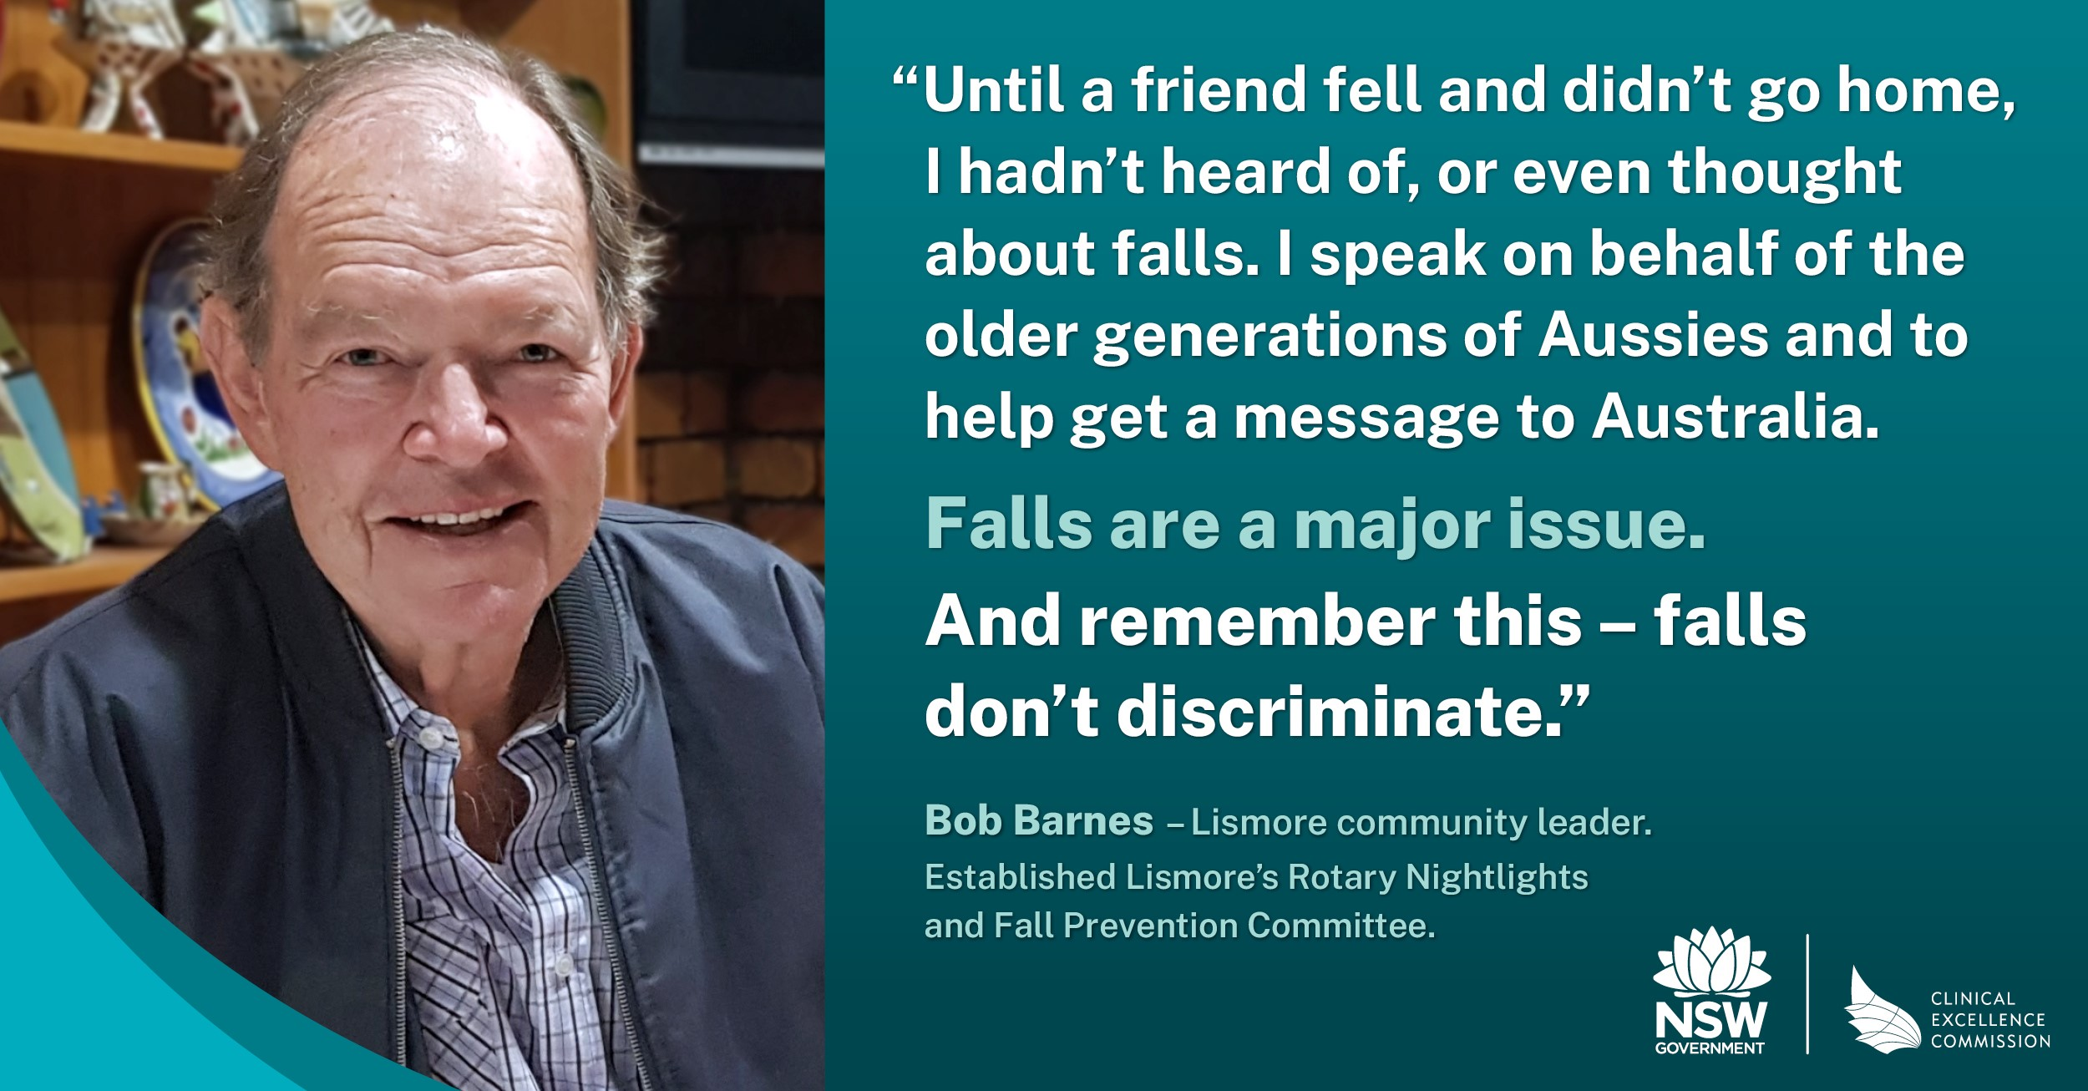
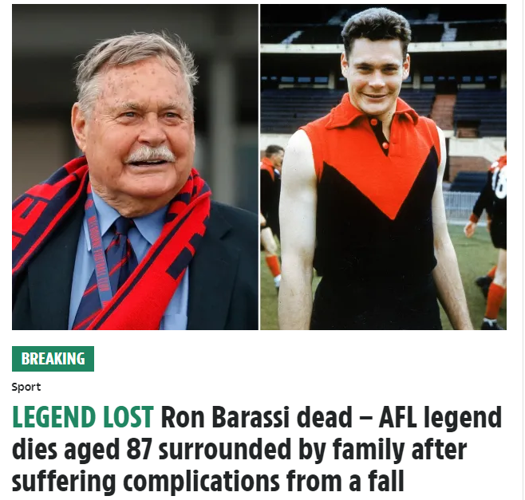
Who Falls?
One in three 65+
https://www.abc.net.au/news/2024-08-26/chef-maggie-beer-fall/104268752
One in two 85+
https://www.the-sun.com/sport/9104883/ron-barassi-dead-afl-legend-87-fall/
Notes:
It doesn’t matter what your age is, anyone can have a fall, you may have already experienced a fall or know of others who have fallen. Falls do not discriminate. While you may not think you are at risk of falls now, it is important to be aware that anyone over the age of 65 especially is at risk of a fall and can do things to reduce their risk of falling.
In older people, falls occur frequently and the risk for a fall increases as you age.
One in three people over the age of 65 years fall each year. This rises to half of those aged over 85 years fall each year
On the right, you can see some examples of some famous people who have had a fall, and these falls often result in serious consequences such as a fracture or even death. As you can see, falls do not discriminate and can happen to anyone at any time

Slide 5
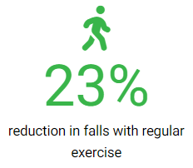
Healthy Ageing and Preventing Falls
April Falls 2025 aims to encourage older people to build awareness and involve all health professionals in the management of falls.
Exercise is the most effective single intervention to reduce the risk of falling.
“…but slowly building up high-challenge balance exercises can increase the effects of exercise by up to 40 per cent”. – Professor Cathie Sherrington
Every move counts.
By safely achieving your goals you can move towards better health today

Slide 6
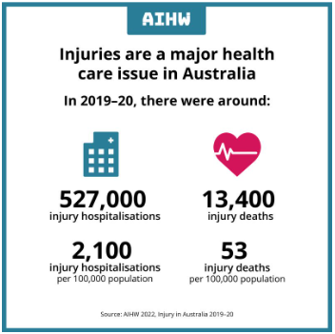

Falls and fall-related injuries don’t just only happen in older adults…
Falls
Falls

Slide 7
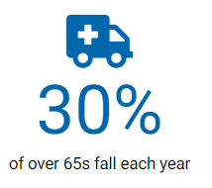
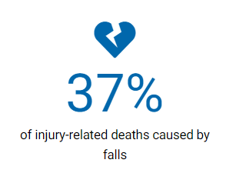
Falls Statistics
There is a large personal cost to falling
Leading cause of injury-related death in older adults (37%)
Leading cause of hospitalisation in older adults (41%)
30% suffer injuries requiring medical treatment
10-15% are serious injuries (e.g. fractures)
  Hip fracture example:
  50% discharged to nursing homes
  25% never regain their pre-fracture mobility
  25% die within 12 months
$3.9b
Estimated annual cost of falls nationally
AIHW 2019: Henley GE & Harrison JE. Trends in injury deaths, Australia, 1999–00 to 2016–17. Injury research and statistics series no. 127. Cat. no. INJCAT 207. Canberra: AIHW.
AIHW: Pointer SC 2019. Trends in hospitalised injury, Australia 2007–08 to 2016–17. Injury research and statistics series no. 124. Cat. no. INJCAT 204. Canberra: AIHW.

Slide 8
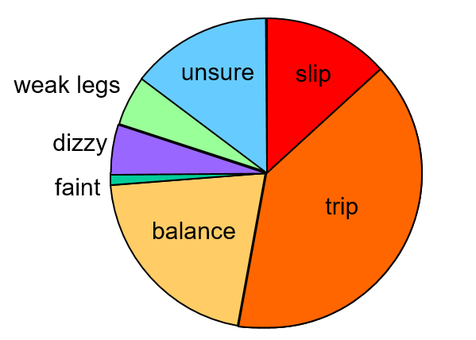
Fall Mechanisms
N=704 women aged 65-99 years
Randomly selected from the community
Slips, trips and balance problems account for almost ¾ of falls
Lord SR, Ward JA, Williams P, Anstey KJ. An epidemiological study of falls in older community-dwelling women: the Randwick falls and fractures study. Aust J Public Health. 1993 Sep;17(3):240-5

Slide 9
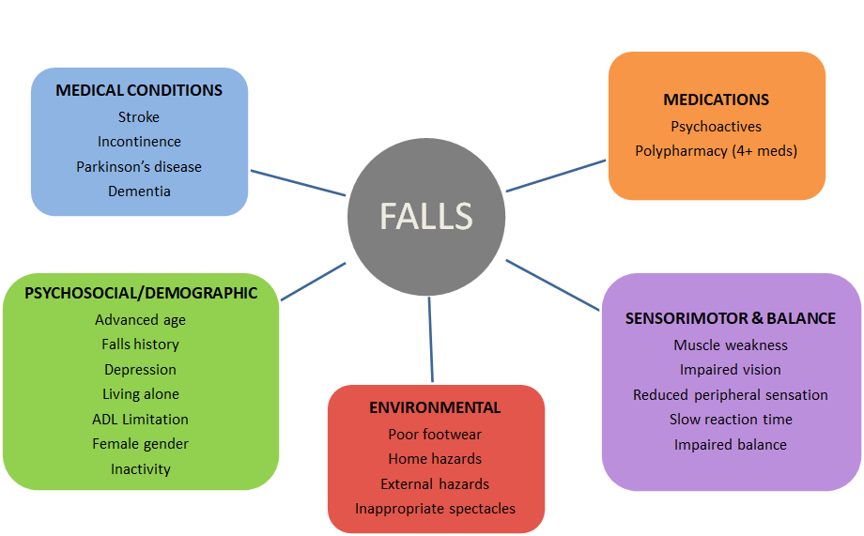
Risk Factors
Notes:
Risk factors can be screened and strategies can be put in place to mitigate risk. EG. Medications review or decluttering of home and living spaces
…but the gold standard for preventing falls is: Physical Activity

Slide 10
Physical Activity
Staying physically active is the single most important thing we can do to stay independent as we age
As people grow older, they lose muscle strength and balance – this can lead to a fall
To reduce the risk of injury from a fall it is important to improve balance and increase strength
High balance challenging exercises should be included in ALL exercise programs.
At least 30mins /day is recommended.
Initially make small changes, adding variety to maintain interest and gradually build up activities over time.
Share your health and fitness goals with your family, friends and work colleagues
Sherrington C, Fairhall NJ, Wallbank GK, Tiedemann A, Michaleff ZA, Howard K, Clemson L, Hopewell S, Lamb SE. Exercise for preventing falls in older people living in the community. Cochrane Database of Systematic Reviews 2019, Issue 1. Art. No.: CD012424.
WHO guidelines on physical activity and sedentary behaviour. Geneva: World Health Organization; 2020. Licence: CC BY-NC-SA 3.0 IGO

Slide 11
Healthy Ageing and Preventing falls
Balance & Functional Exercises
Resistance (strength) exercises
Tai Chi
Home based or group classes
Reduces the rate of falls and number of people who fall
May help prevent fall related fractures
Home based or group classes
Done in conjunction with balance training for best effects.
Benefits on fall rates when done alone are uncertain
Home based or group classes
Reduces the number of people who experience a fall and may reduce the rate at which people fall
Exercises that include balance and functional exercises and are undertaken for more than 3 hours per week are particularly effective.

Slide 12
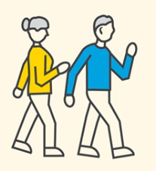
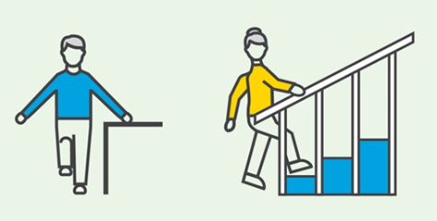
Exercise to Prevent Falls
Exercise is effective to prevent falls!
Important components of exercise programs to prevent falls
Exercises should be performed often – at least 2-3 hours per week
Maintaining the exercise program is key – the goal is to develop a lifelong habit – exercise performed for at least 6-months
Balance should be challenged
Many types of exercises can be performed including balance, strength and function
Notes:
Exercise is a simple and highly effective intervention to reduce the rate of falls. When looking at the studies which have been performed that looked and exercise and falls, it has been found that exercise can reduce the rate of falls by over 20%
Research has shown that there are some key components of an effective exercise program to reduce falls
Exercise programs should aim to be performed regularly and for a long period of time. It is important to make exercise a lifelong habit as we know that the body, no matter what age can change and respond to the lifestyle. With exercise programs, the body can improve by getting stronger and more balanced but if we stop exercising, the opposite can occur. To prevent falls, research has shown that exercise should be performed 2 to 3 hours per week
Exercises need to challenge the persons balance. If you are able to perform an exercise easily, it is important to progress the exercise and make it more challenging. This constant improvement can work to further protect you from falling.
Finally, research has shown that programs can include some variety to achieve the benefits for fall prevention. Instead of thinking of performing the same exercises like those at the gym you could add exercises to the activities you already do. For example you may do some sit and stand exercises while watching tv or some balance exercises while making a tea. The important thing is to challenge the body and your balance.

Slide 13
Challenge Your Balance
A HIGH CHALLENGE to balance is needed in exercise programs. There are several ways this can be
achieved with exercises:
Increasing time or repetitions
Reducing / removing support
Narrowing your support
Adding movement
Adding a task
Safety is KEY!
Notes:
There are several ways to challenge a person balance
First, you can increase the time or repetitions that are performed. For example, instead of doing a balance exercise such as a feet together stand for 10 seconds, aim for 30 seconds. Or instead of doing 10 repetitions of a sit to stand, aim for 20 repetitions
Second, you can reduce or remove the support you are using. If you are holding onto the wall or a chair for support during balance exercises, try to hold on with only one hand, or a few fingers, or only touch the support when needed.
Third, you can narrow your support. Standing with your feet wide apart increases your support, whilst standing with your feet together or with one foot in front of the other reduces the support and can make exercises feel much more difficult
Fourth, you can add movement to your exercise. If you usually perform an exercise standing still, try to add movement. This could be something simple like raising your arms out to the side and back or changing the exercise from a standing to walking one. Adding movement makes your body work harder as your more muscles are needed to keep you stable
You can also add a task to the exercise you are doing to make it more challenging. Multi-tasking makes it so that you can’t focus on one task. An example would be counting backwards or naming animals while balancing.
Lastly, it is important to ensure any progressions are made in a safe manner. If you find it too difficult, you can always go back to doing exercises the way you were doing without the progression. The goal is to challenge the body in a safe way that doesn’t lead to you falling.

Slide 14
What type of exercise?
Balance intensity and dose effects
Low challenge +
<3 hours
Mod-high challenge +
>3 hours
Falls rate
10%
39%

Slide 15
Exercise Tips and Considerations
Quick tips
Exercise can be broken into shorter session (for example 3x 10 min sessions)
Choose activities that you enjoy
Find an exercise partner to share your journey
Considerations
In some cases, it may be important to speak to your GP before beginning exercises for advice on the effect of medications
Health professionals such as physiotherapists and exercise physiologists can help to create a program targeted to your needs and health

Slide 16
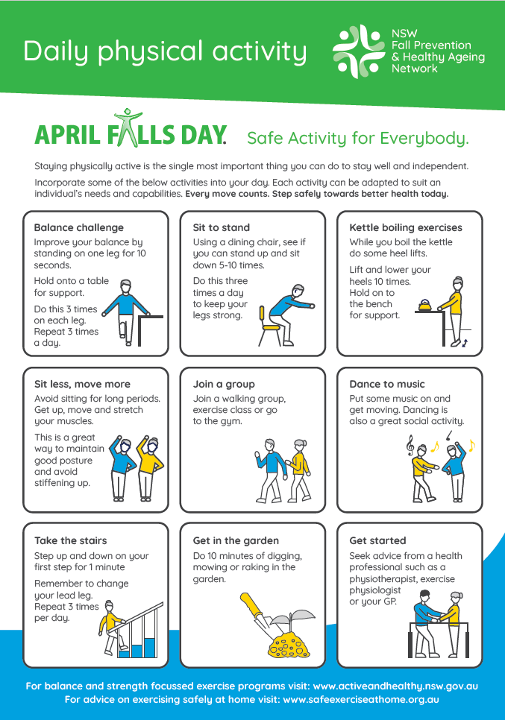
Daily Physical Activity: Campaign Flyer
Notes:
Tips on how to keep active

Slide 17

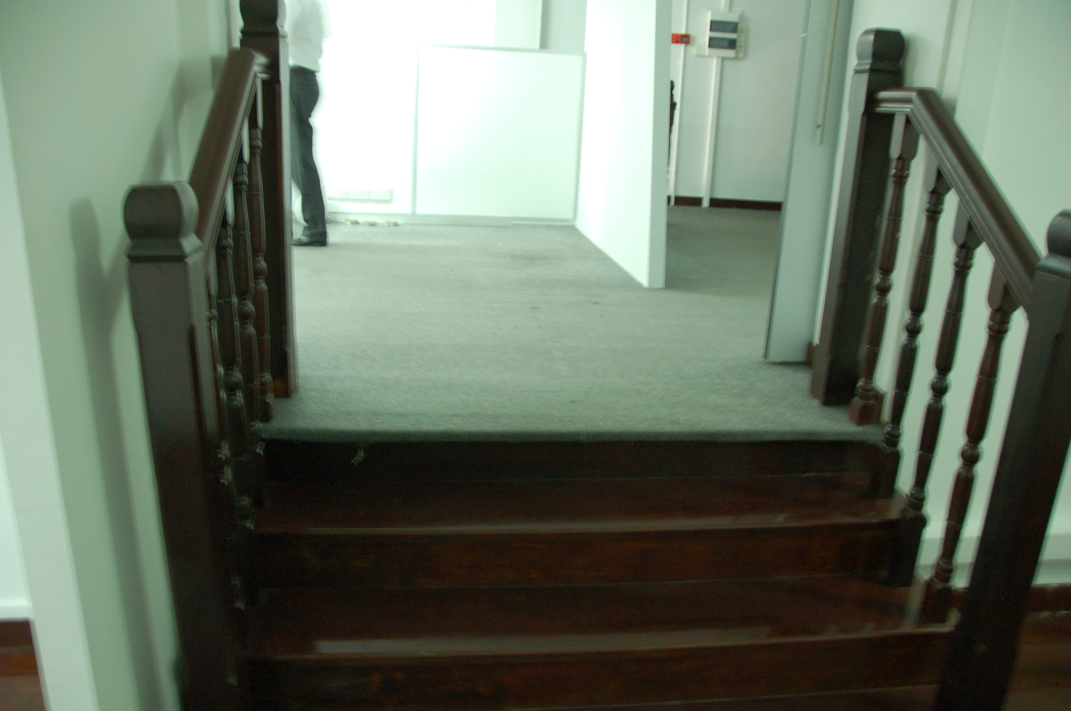
Reduce Your Fall Risk at Home
Environment Hazards
Remove hazards: such as cords and wires, rugs and lighting
Clean spills or slip hazards immediately
Replace/reduce hazards: use nonslip rugs or mats
Install safe options: handrails in the bathroom or stairs, night lights for safe moving at night
An occupational therapist may assist in assessing and
  managing hazards in the home
https://www.pexels.com/photo/electric-lamp-on-the-wall-in-a-room-26616632/
https://www.immerse.zone/detail/539062241420357-wooden%20stair%20railing-stair%20handrail-wooden%20stairs
Notes:
Around half of the falls that older people experience happen at home, whether that is indoors such as in the kitchen or outdoors in the garden
The home environment can be full of hazards that increase the risk for falls.
Firstly, it is important to ensure places where you move are free of clutter. Wires and cords should be removed from walking areas. Clean slip hazards such as spill immediately
If you can’t remove hazards, it is then important to replace the hazards with a safer alternative. For example, non-slip rugs or mats can be used. You can also mark a hazard so that you can be reminded to take care at certain locations. For example you could mark the edges of steps
Finally, you can install items to improve safety. Handrails could be installed in the bathroom, or near stairs. Lighting can also be important, especially where stairs are located and when moving around at night.
An occupational therapist can perform a home visit to assess and provide recommendations to reduce the risk of having a fall at home

Slide 18
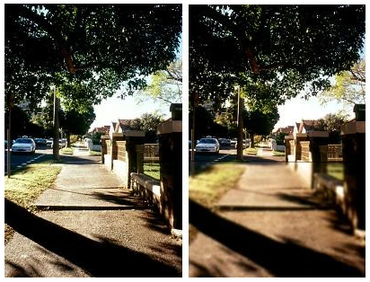
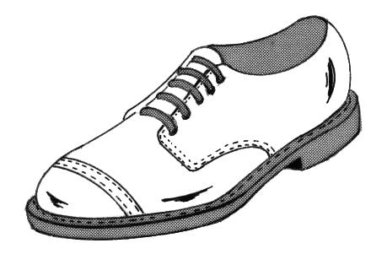
Correct Your Hazards
Single Lens Bi/Multi-focal
Vision
Get your eyes tested by an optometrist and correct any deficits or problems
Replace bi or multi-focal glasses with single-lens glasses
Footwear
Wear shoes that are well fitted and support the feet
Laces to secure the foot
Wide toe box
Correct shoe length
https://bmcgeriatr.biomedcentral.com/articles/10.1186/1471-2318-9-10/figures/3
https://garystockbridge617.getarchive.net/media/blucher-psf-85e6d4
Notes:
The equipment and items you use can also play a role in your fall risk. First, it has been shown that bi or multi-focal glasses can impair your vision, as you can see in the image on the right, where the lower half of vision is obstructed or blurry when using multi-focal glasses. Therefore, you should use single vision lens, for example, one for reading and one for outdoor use.
Footwear can also be important. If possible, avoid wearing socks or slippers at home. And when wearing shoes it is important to ensure they are well fitted, correct in length and have a wide box area for your toe. Other foot issues may require more targeted interventions

Slide 19

Manage Medical Conditions
Feet
Podiatrist review of the feet and intervention for people with
  disabling foot pain
Eyes
Correct eye problems such as the removal of cataracts
Medication
Having enough vitamin D is also important for bone and muscle health
Gradual reduction in psychoactive medications
Medication review – by your GP or a geriatrician
https://www.deprescribingnetwork.ca/environment
Notes:
If you have any medical conditions, specialised assistance such as from your GP, a podiatrist or geriatrician are listed on this slide.
For those with foot pain, it may be worthwhile to visit a podiatrist to look at your feet, for example, if you have issues such as bunions. Footwear can also be modified and exercises performed to strengthen the foot muscles and manage or correct the causes of pain
Vision – it is important that those with problems with their eyesight see the appropriate specialist to have them corrected. Cataract removal has been shown to reduce fall risk, as has the removal of bi or multifocal glasses as the lens can make it harder and confusing when you see the edges of steps or the footpath
Medication – Having enough vitamin D is important to maintain bone and muscle health. Having strong bones with nutrition and exercise can help prevent fractures. There are supplements for vitamin D but they can also be taken with dairy foods, oily fish such as salmon, eggs and sunlight. Some medications, such as those for anxiety, depression or sleep issues can increase the chance of having a fall. In addition, people with a lot of chronic conditions may be taking many medications which can interact with each other to increase the risk for a fall. Therefore, it is worthwhile to have your GP or a geriatrician to review the medications you are taking and decide if they are required or can be improved

Slide 20
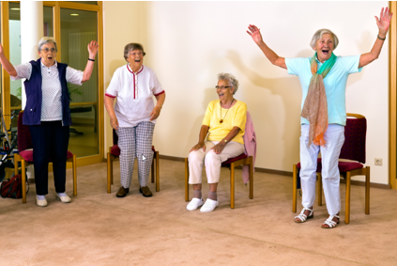
Social Engagement
Feeling socially connected can:
  Improve your quality of life
  Boost your mental health
  Increase levels of happiness
  Increase feelings of belonging
  Result in fewer health problems
  Help you live longer

Slide 21
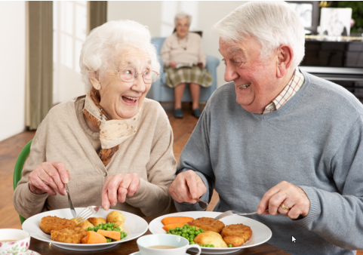
Healthy Eating
Eating well to prevent falls – a dietician or nutritionist may assist
Eating healthy food with adequate energy and protein is important to maintain:
  muscle mass
  muscle strength
  To reduce the risk of:
  sarcopenia (muscle wasting)
  frailty and
  fall-related injury
Notes:
From nutrition and hydration – eating well to prevent falls CEC april falls preso

Slide 22
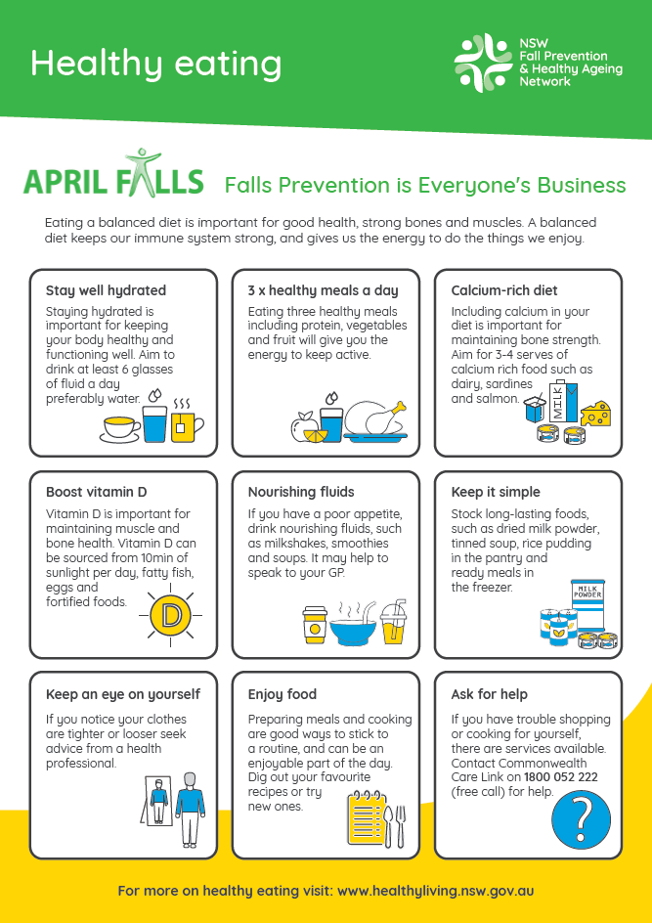
Healthy Eating: Campaign Flyer

Slide 23
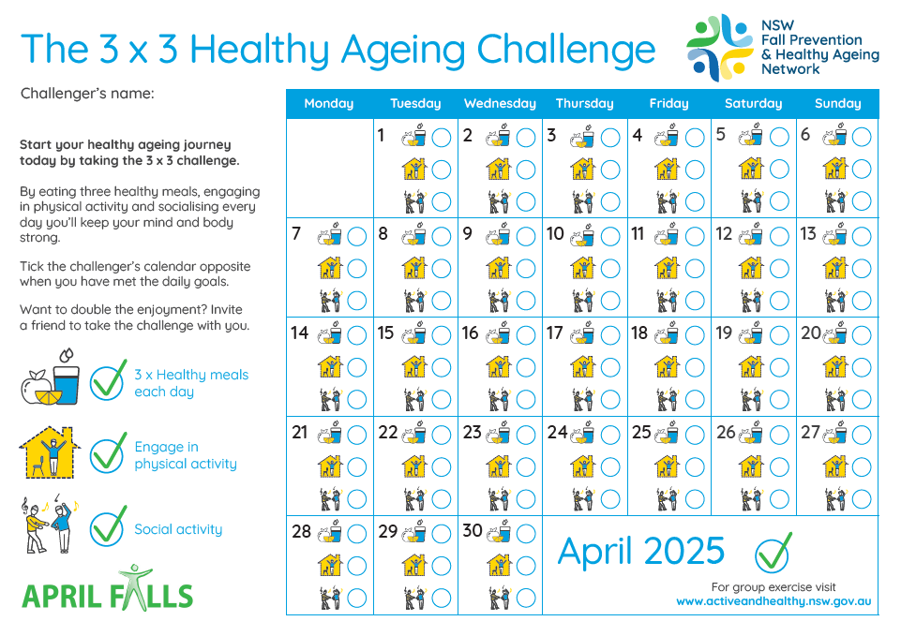
3x3 Healthy Ageing Challenge
For staff, patients and care-givers:
Share your health and fitness goals with your family, friends and work colleagues!

Slide 24
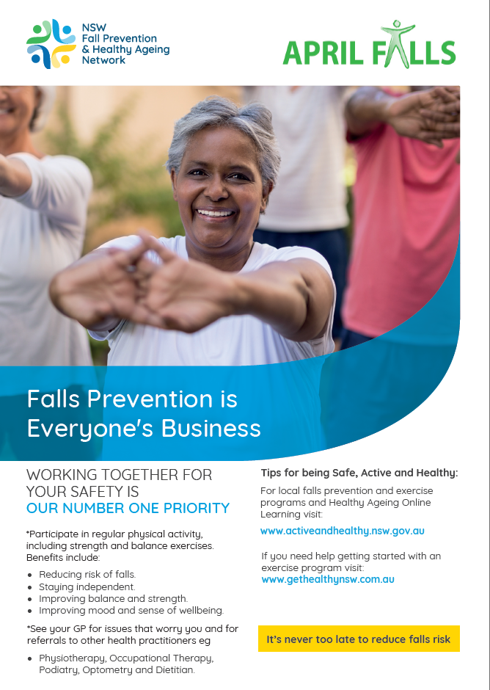
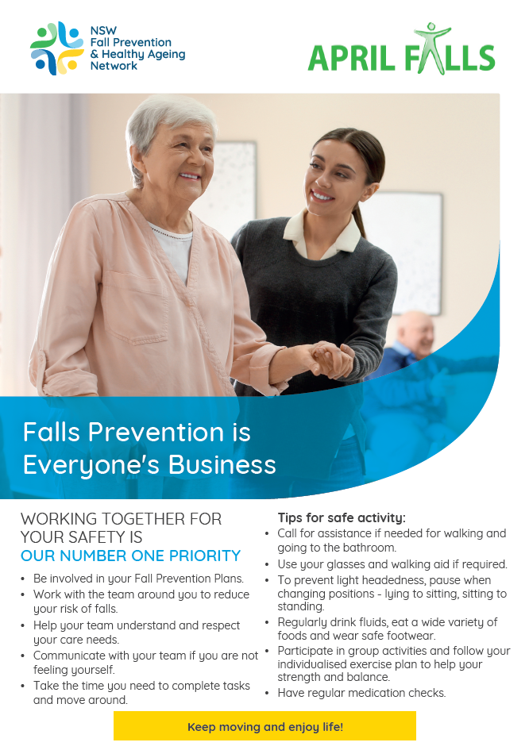
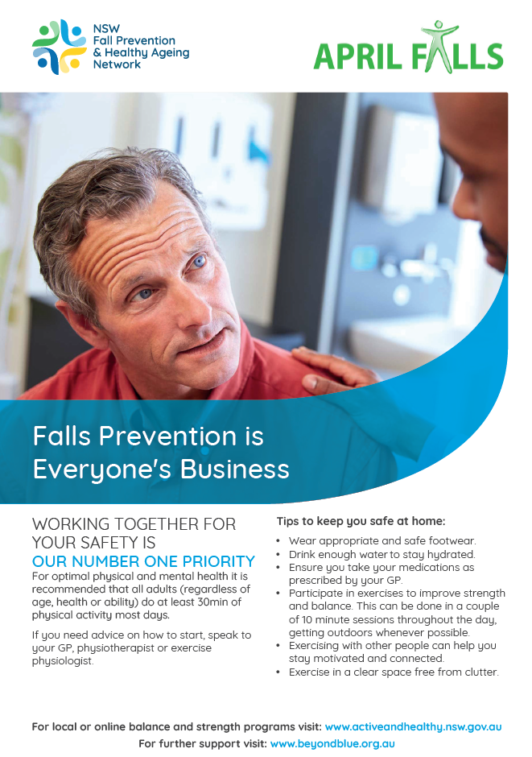
Campaign flyers

Slide 25
Other Resources
Active and Healthy – Exercise Manual
https://www.activeandhealthy.nsw.gov.au/assets/images/healthy-ageing/Exercise-Manual.pdf
Active and Healthy – Healthy Ageing Online Learning Modules
https://www.activeandhealthy.nsw.gov.au/active-living/healthy-ageing-online-learning/
Safe Exercise at Home
https://www.safeexerciseathome.org.au/
Choose Health – Be Active Guide
https://www.health.gov.au/sites/default/files/documents/2021/03/choose-health-be-active-a-physical-guide-for-older-australians.pdf
Stepping On
https://www.steppingon.com/

Slide 26




Find an Allied Health Professional
Exercise Physiologist
https://www.essa.org.au/Web/Web/Member-location-search.aspx
Physiotherapist
https://choose.physio/find-a-physio
Occupational Therapist
https://otaus.com.au/find-an-ot
Podiatrist
https://www.podiatry.org.au/find-a-podiatrist

Slide 27
Acknowledgements
The April Falls Working Group
  Margaret Armstrong
  Holly Austine
  Maree Connolly
  Lisa Delaney
  Michael Fahy
  Lucy Haver
  Ingrid Hutchinson
  Nicole Hill
  Joanna Lyons
  Michelle McGregor
  Steven Phu
  Ash Wright

