Slide 2
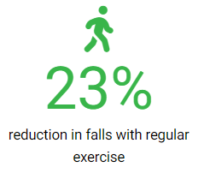
Outline
April Falls 2025 aims to encourage older people to build awareness and involve all health professionals in the management of falls.
Exercise is the most effective single intervention to reduce the risk of falling.
“…but slowly building up high-challenge balance exercises can increase the effects of exercise by up to 40 per cent”. – Professor Cathie Sherrington
Every move counts.
By safely achieving your goals you can move towards better health today

Slide 3
Comprehensive Care
Partnering with Consumers
Communicating for safety
Notes:
Falls Prevention in Hospital is guided by the National Standards and the international Falls Prevention Guidelines. There will be new National Best practice guidelines for Australian being released this year by the Australian Commission on Safety and Quality in Health Care.
The Australians Commission on Safety and Quality in Health Care, National Safety and Quality Health Service (NSQHS) Accreditation Standards to provide a nationally consistent approach to providing quality care.
These 3 standards are closely interconnected and all work together to keep patients safe in hospital
Standard 2 – Partnering with Consumers – involving patients/ families and carers as partners in their planning of care
Standard 5 – Comprehensive Care Standard – Comprehensive Care planning process includes an integrated individualised screening and assessment process in collaboration with patients, carers and families to develop a goal-directed comprehensive care plan.
Standard 6 – Communicating for safety- Communication is a key safety and quality issue, and is critical to the delivery of safe patient care

Slide 4
Using Data for Improvement
Understanding your falls data/incidence on your ward to key to preventing falls:
Age of patient
What time of day do most falls occur?
Where do most falls occur?
What are the patients doing at time of fall? Eg getting out bed, on the way to the bathroom
What are the contributing factors?

Slide 5
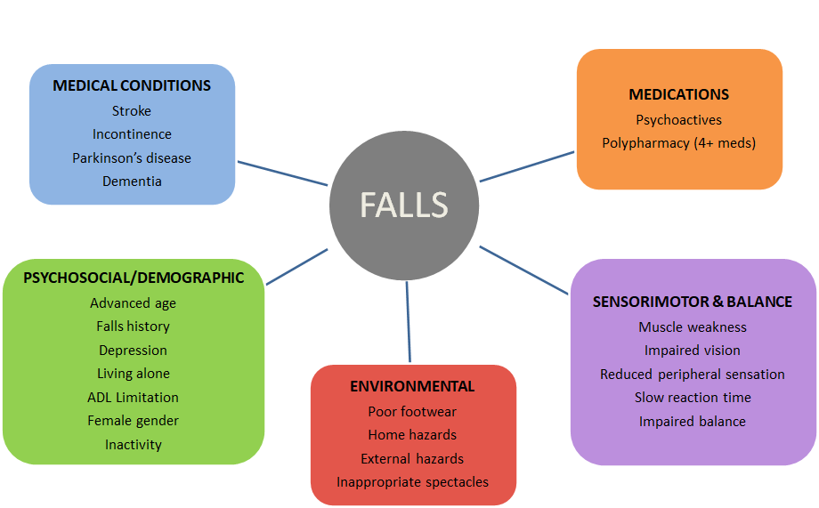
Risk Factors
Notes:
Risk factors can be screened and strategies can be put in place to mitigate risk. EG. Medications review or decluttering of home and living spaces
…but the gold standard for preventing falls is: Physical Activity

Slide 6
Examples of Fall Risks
Cognition
Delirium
Mobility status
Personal Care/toileting
Poor vision/hearing
Environmental factors
Nutrition and hydration needs
Comorbidities
Medications

Slide 7
Quality markers for care of older people
Quality Care
Continence
Pressure Injury
Nutrition & hydration
Cognitive impairment
Medication safety
Falls
Continence
Falls
Cognitive Impairment
Medication safety
Nutrition & Hydration
Pressure Injury
Professor Jacqueline Close, Geriatrician, POW Hospital
Notes:
Its important to think of all the factors to consider when caring for older people in hospital to provide person centred care to keep people safe in hospital

Slide 8
Falls prevention is everyone’s business
How can we keep patients safe and prevent a fall?
Identify patient fall risk factors
Involve patient, families and/or carers and consider goals of care
Plan, document and implement care plan/strategies
Timely referrals to MDT team
Communicate patient’s fall risks and care plan to all staff involved in the patient’s care.
Notes:
Involving the whole MDT ward team in the care of patient.

Slide 9
Falls prevention is everyone’s business
Patients' perspective
Patients consider themselves safe in hospital and don’t think that they could fall.
Patients are in an unfamiliar environment and are unwell
Patients won’t know what their fall risks are and how they will be managed in hospital unless you discuss it with them and/or their Carer.

Slide 10
Communicating with patients
Talk with patients, families and/or carers - they won’t understand their risks unless staff discuss with them
Discuss with patients, families and/or carers how to stay safe in hospital e.g. assistance with mobilising or call for help
Keep the communication in simple language – no medical jargon
Encourage those that can, to use their call bell and wait for assistance
Notes:
Informing patients why we feel they are at risk. – what we will be doing to reduce those risks in hospital at the moment

Slide 11
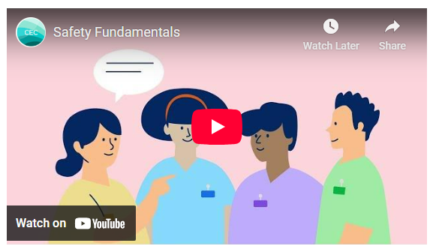
Communicating with MDT Staff
The Clinical Excellence commission promotes the Building blocks for a safe ward/Safety fundamentals
The building blocks are communication process that enable patient safety risks to be communicated to the Multi disciplinary team throughout the day.
https://www.cec.health.nsw.gov.au/improve-quality/system-safety-culture/safety-fundamentals/for-teams
Notes:
Effective teamwork and communication are foundational elements in a culture of safety and are key elements of high reliability organisations. Our inability to communicate effectively within teams and with patients and their carers is directly linked to patient harm

Slide 12
Building Blocks for a Safe Ward

Slide 13
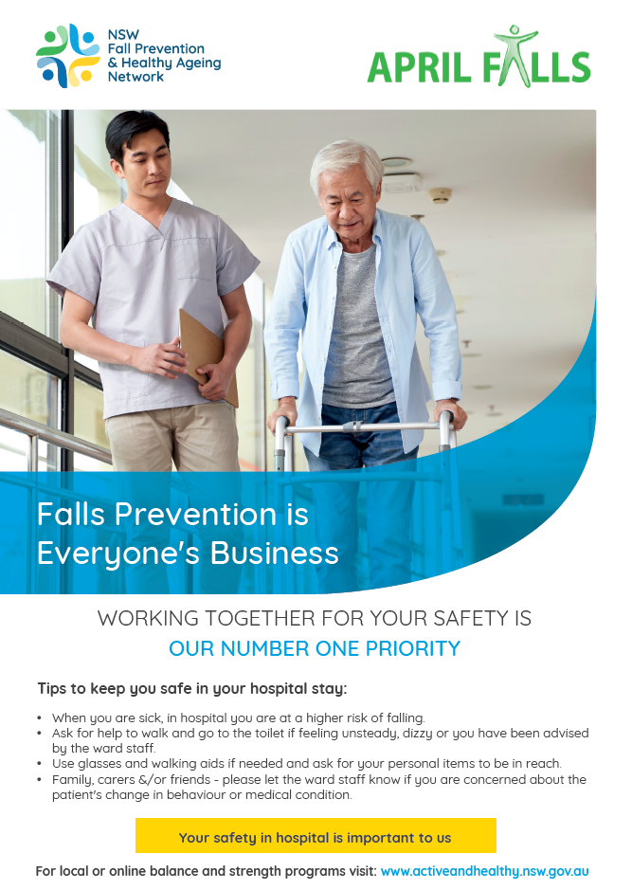
Resources available for April Falls 2025
Additional posters for:
Paediatrics
Maternity
Mental Health
Additional resources including:
3×3 Healthy Ageing Challenge
Healthy Eating
Scan QR code to access

Slide 14
Other Falls Resources
CEC – Older Persons Patient Safety program https://www.cec.health.nsw.gov.au/keep-patients-safe/older-persons-patient-safety-program
Email: cec-oppsp@health.nsw.gov.au
Active and healthy website
www.activeandhealthy.nsw.gov.au
For access to information of local physical activity programs on discharge, home safety checklist and Healthy Ageing Online Learning

Slide 15
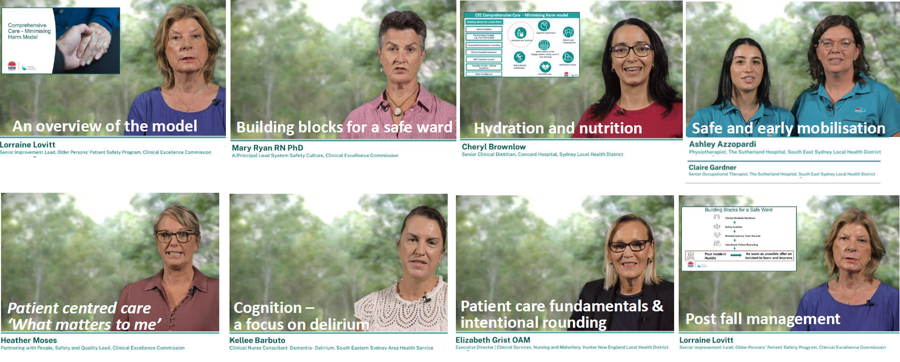
Resources to support care of the older person
https://www.cec.health.nsw.gov.au/keep-patients-safe/older-persons-patient-safety-program/comprehensive-care-minimising-harm/videos-and-education

Slide 16
NSW Fall Prevention and Healthy Ageing Network
Join the NSW Fall Prevention and Healthy Ageing Network to receive:
Newsletter updates of events and research
Monthly falls research updates
Details of events including:
Annual Falls Forum
Rural Forums
Exercise to Prevent Falls in Older People Workshops
Webinars and learning activities
Scan QR code to subscribe
Notes:
Informing patients why we feel they are at risk. – what we will be doing to reduce those risks in hospital at the moment

Slide 17
Acknowledgements
The April Falls Working Group
Margaret Armstrong
Holly Austine
Maree Connolly
Lisa Delaney
Michael Fahy
Lucy Haver
Ingrid Hutchinson
Nicole Hill
Joanna Lyons
Michelle McGregor
Steven Phu
Ash Wright

